Slide 1
Local log markets
Presentation prepared by: Lauren Grand, Extension agent, Oregon State University

Slide 2
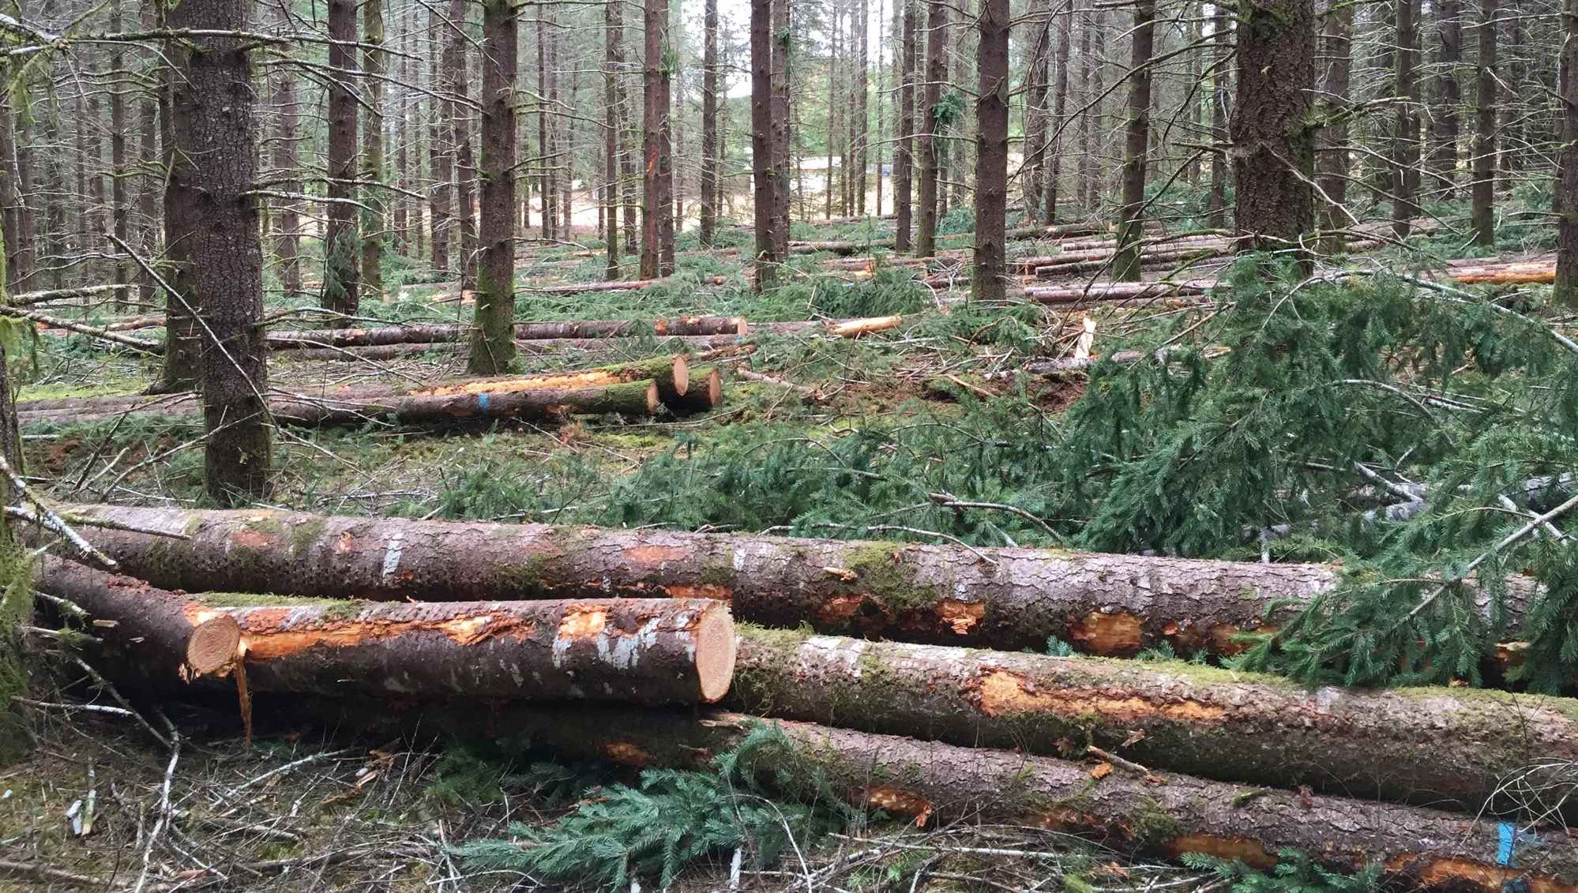
Timber Marketing is the art and science of selling timber to reach as close to its true market value as possible.
Photo: Glenn Ahrens, © Oregon State University
Notes:
Timber marketing success relies on an understanding of local timber products, a good estimate of what a landowner has for sale, an understanding of yearly market fluctuations and trends, and competition between buyers for the products offered.

Slide 3
Video: income opportunities from logs
Photo : Lynn Ketchum, © Oregon State University
Notes:
https://youtu.be/9KkY_Uvx0Ys

Slide 4
What are you selling?
Notes:
A timber cruise can estimate the volume of wood and identify the product types and tree quality. This is best done by a professional forester with the training and experience to designate product types of standing trees. A comprehensive cruise helps landowners match what they have with the right mill, sort yard or product line to receive premium prices for logs.

Slide 5
Cruise the sale
Forest survey of what you plan to sell — sample
Itemized by product — species, size, volume, quality, or other characteristics
Log lengths reflective of actual cutting practice
Photo: Lynn Ketchum, © Oregon State University
Notes:
A timber cruise is a survey to locate and estimate the quantity of timber on a given area, according to species, size, quality, possible products or other characteristics. A cruise can estimate the volume of different products in the stand, as well as offer log lengths reflective of cutting practices. A forest inventory is often confused with a timber cruise. A forest inventory is a sampling method designed to quantify the spatial distribution, composition, and rate of change of forest parameters for the purposes of management. Inventories may be made of all forest resources including vegetation, fish, insects, wildlife and other forest conditions or factors. Inventories often have fewer plots than a cruise and therefore aren’t as accurate of an estimation of what you are going to sell.

Slide 6
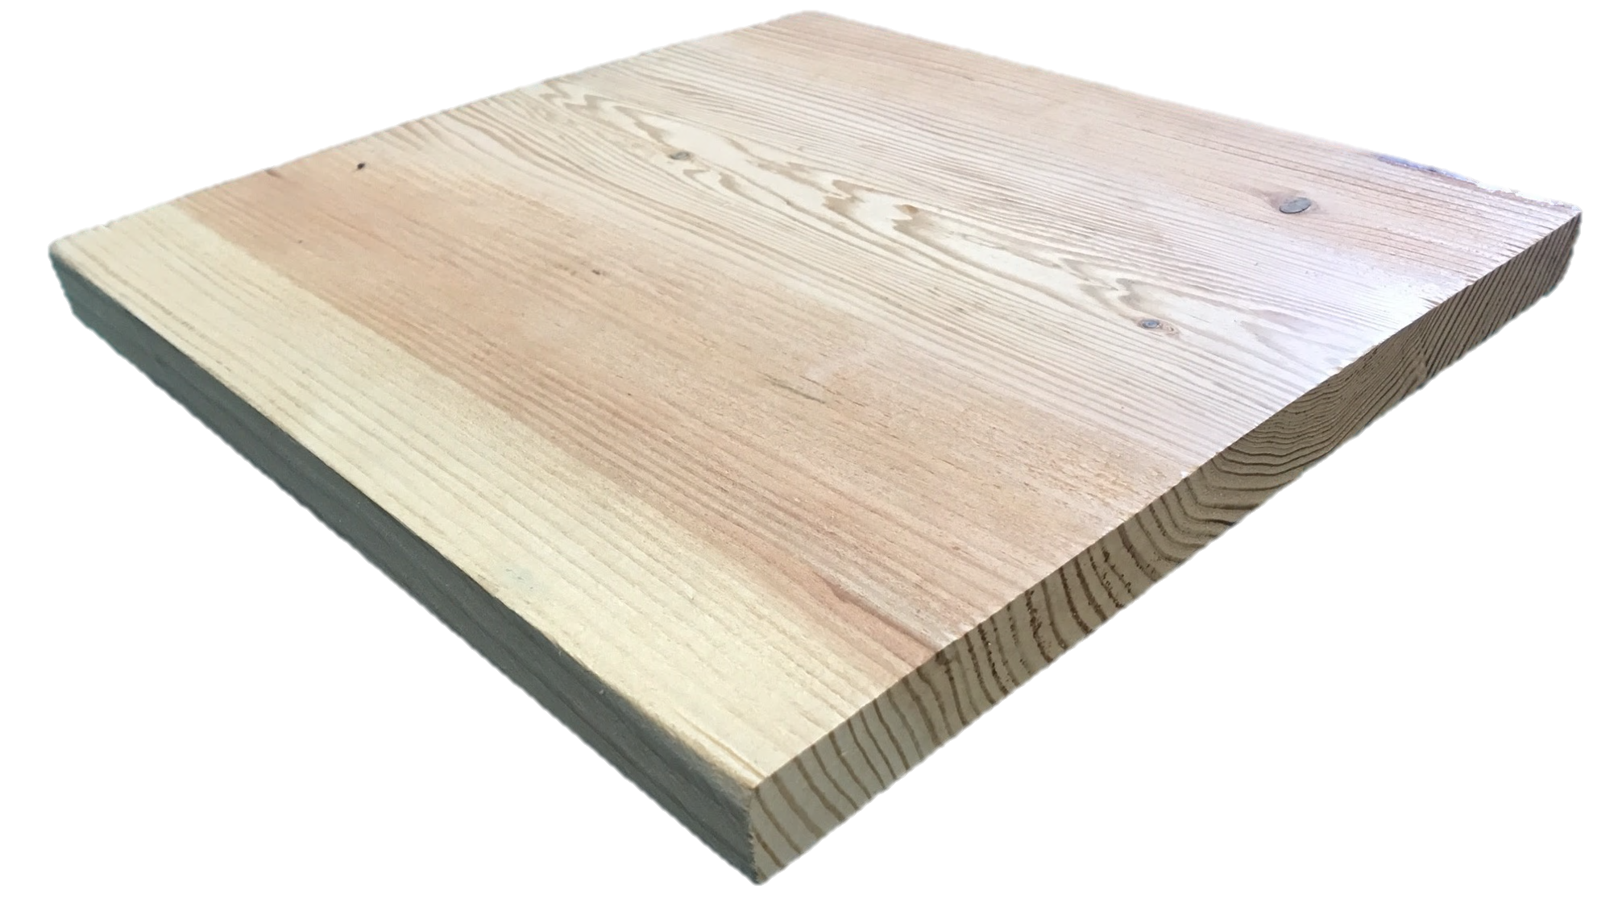
What is a board foot (BF)?
1 inch
1 foot
(12 inches)
1 foot
(12 inches)
Photo: Lauren Grand, © Oregon State University
Notes:
In the western U.S., most transactions with logs and lumber are in “Scribner board feet.” A cruise is often reported in board feet per acre, while values are reported as dollars per thousand board feet (MBF). But what is a board foot? A board foot is a unit of volume for timber typically measured as 12 inches by 12 inches by 1 inch, or 144 cubic inches of any dimension.

Slide 7
Scribner Rule – current method of payment for log volumes
Diagrammed 1-inch boards with ¼-inch saw kerf reasonably cut from cylinders of various sizes
$\frac{Total inches of width}{12}$ =BF per foot of log
$\frac{4+8+12+12+12+12+12+12+12+12+8+4}{12}$ =
$\frac{120}{12}$ = 10 bf per 1 ft of log
4”
8”
12”
12”
12”
12”
12”
12”
12”
12”
8”
4”
Notes:
Note to the presenter: While Scribner board feet are the convention in the Pacific Northwest, you may need to adjust this slide if it is not the common rule or convention in your region.
Created in 1846 by J. M. Scribner
The Scribner Rule is a “diagram rule,” based on board foot volume for a log of any given small-end inch-diameter, developed by actually drawing in properly dimensioned 1-in.-thick board ends, not less than 4 in. wide, that can reasonably be cut from a circle with equivalent diameter, after wasting slab areas and allowing for ¼ in. of saw kerf waste between the boards. Dividing the total inches of width in these theoretical boards by 12 gives the number of board feet per lineal foot of a log. Example: 120/12 = 10 BF per 1 ft. of log. 12 ft. log: 12 X 10 = 120 BF 16 ft. log: 16 X 10 = 160 BF 40 ft. log: 40 X 10 = 400 BF

Slide 8
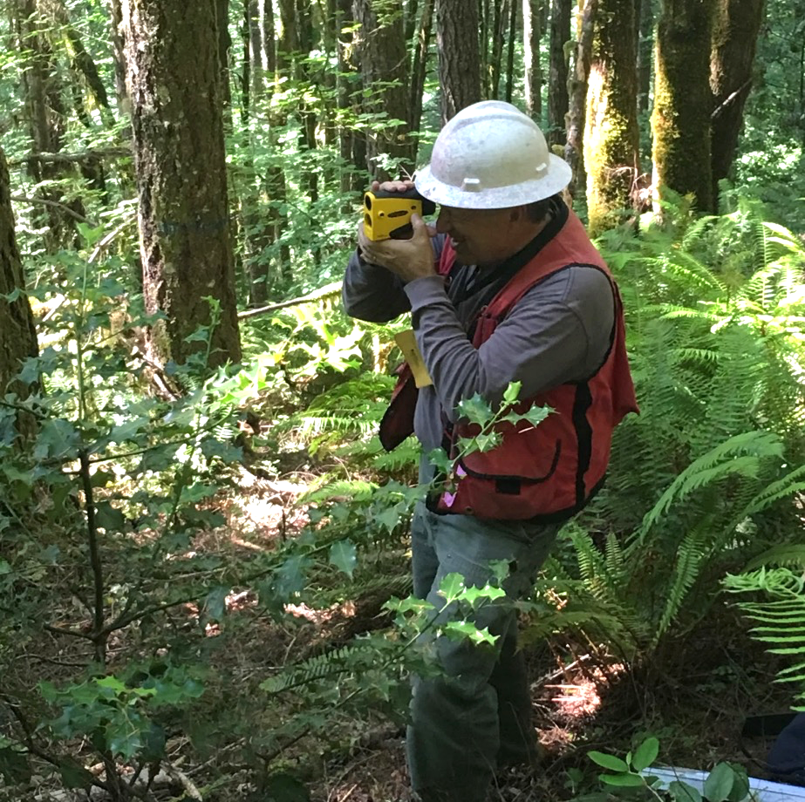
What to look for in a timber cruiser
Appropriate equipment
Laser for tree height
GIS software for maps
Cruising software
Other landowner referrals
Easy-to-understand reports
Clearly explains work
Low margin of error
Experience with defect and grade!
Photo : Lauren Grand, © Oregon State University
Notes:
Timber cruising is usually the specialty of a consulting forester. Not all consulting foresters cruise timber. Talk to at least three cruisers when making your decision. To find the right consultant, ask candidates about their approach to your specific needs. What are their qualifications? Timber cruisers should have experience cruising and identifying how your logs fit into the different defect and grade categories. What equipment do they use? Cruisers should use advanced tools such as lasers for tree heights and GIS and cruising software. Can you speak with some of their clients with similar property and goals? Talk to other small landowners that have used their services. Are the landowners happy with the work? Were their reports clearly presented and easy to understand? Could the cruiser communicate their findings with them in a way they understood?

Slide 9
Appraise the sale

Slide 10
What’s the value?
From cruise
Species, quality, dimensions
What is the demand?
Market trends
Current prices
Notes:
After identifying which trees to harvest, you can extrapolate the volume and approximate quality by species from the cruise. Use the volume data collected in the cruise along with price estimates received from local log buyers to calculate a possible range in fair market value. If a professional forester is being consulted, they should provide you with this estimate. Use it only as a guide to evaluate purchase offers or bids.

Slide 11
Average annual log values
Notes:
How the average prices for local marketable species have changed over the last 40 years. Change graph for your local species and prices. Recent and historic log values are often available from the state department of forestry or natural resources. You can also get past prices by calling mills directly. Use this opportunity to comment on how policy and external markets can change the trends. For example, a housing crash, international trade agreements, tariffs and harvesting on federal lands.

Slide 12
Douglas-fir sawlog prices: monthly trends
Notes:
Discuss how markets fluctuate yearly in your area. Some reasons may include:
Prices begin to rise in fall and stay high through winter and spring because trees are harder to access in wet weather. Fewer landowners have rocked roads or the ability to use aerial harvesting systems, which minimize soil impacts during the rainy season. With fewer logs entering the market, demand increases, and so do prices.
Sometimes prices rise in August or September due to mill inventory reductions. If fire weather is extreme that year, some locations in the West shut down logging operations to decrease fire risk. This decreases the number of logs entering the market, increasing demand.
Douglas-fir sawlog prices are heavily tied to the housing market. In spring, lumber prices rise as housing starts increase during peak building season. This drives up lumber prices and log prices.

Slide 13
Frequency of months with the highest and lowest prices for Douglas-fir
Notes:
This graph shows the amount of times a specific month has had the highest prices (green) and lowest prices (orange). The best prices usually happen between March and May. The worst time to sell is August, because everybody has road access in summer and there are tons of logs in the sawmill log yard.

Slide 14
Hitting the peak price
Log values are determined in anticipation of future markets:
Sell here
Not here
A bullish market will reflect more $/MBF than existing orders.
A bearish market will reflect less $/MBF than existing orders.
Notes:
Bullish: When traders are bullish about an asset, they believe that its price will rise. Bull markets feature rising prices. For example, if you talk to a log buyer about prices in spring, they will usually inflate their prices because price goes up in the spring.
Bearish: When traders are bearish about an asset, they believe that its price will fall. Bear markets feature falling prices. The opposite is true about logging prices. A log buyer will offer a more conservative number in summer, because prices tend to fall at that time.
Having a long-term view of the market will help you anticipate when the market turns. Long-lasting relationships with log buyers can help you anticipate what they are thinking and whether they anticipate prices increasing or decreasing.
Moral of the story: It pays to shop around … always! Second moral of the story: Don’t get greedy! If you wait too long in a bullish market to get just a few more dollars, you could miss the peak and get a lower price than if you sold earlier.

Slide 15
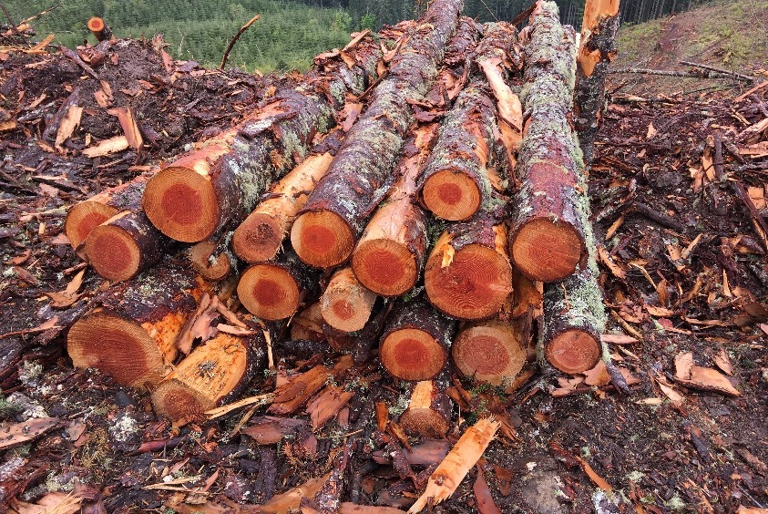
Selecting a buyer
Invite 3 to visit
Match your timber to buyer product lines
How far is the mill?
Photo: Lauren Grand, © Oregon State University
Mill | Offer | Haul cost | Best deal
A | $700/MBF | $35/MBF | YES
B | $715/MBF | $50/MBF
Notes:
Contact at least three log buyers, if possible, to compare price information. Additionally, it is common that one buyer will not take all your logs, so talking to more will help you market all of your trees. Landowners can find log buyer contact information by searching a local forest industry directory or log buyer list. Landowners will need to provide species and approximate volume (or at least acreage) information and invite the log buyer to provide an on-site bid. When choosing log buyers, the main goal is to find buyers with product lines that best match the timber on the property, as buyers will pay more for logs that give them the best value for the type of product they manufacture. Keep in mind transportation costs in relation to the price offered for the product. If the landowner plans to conduct timber sales regularly, it is good to build a working relationship with log buyers.

Slide 16
Stumpage sale vs. mill sale
Standing timber
Cut logs
Photo: Lauren Grand, © Oregon State University
Photo: Francisca Belart, © Oregon State University
Notes:
Explain the advantages and disadvantages of both types of sales. Mill sales give the landowner more control in the aspect of hiring the logger and marketing the timber. Stumpage sales give the risk and profit to the buyer, but the landowner does not have to manage the sale.
Stumpage sales (selling the standing timber)
Relatively easy to administer.
Minimum marketing skill.
Encourages removal of all timber (lump sum).
Accurate cruise required (lump sum).
Monitoring required (scale out).
Fixed price throughout contract.
Buyer determines logger.
Profit and risk factor go to buyer.
Option of timber deed (fixed price and potential for extended time for harvest).
Mill sales or cut logs
Maximum value.
Profit and risk factor go to you.
Ability to “play the market.”
Landowner determines logger.
Marketing skill required.
Requires additional time to administer.
Monitoring required.
Ability to modify operations in written contract (if applicable).
Option to cease operations.
Possible variability in log values.

Slide 17
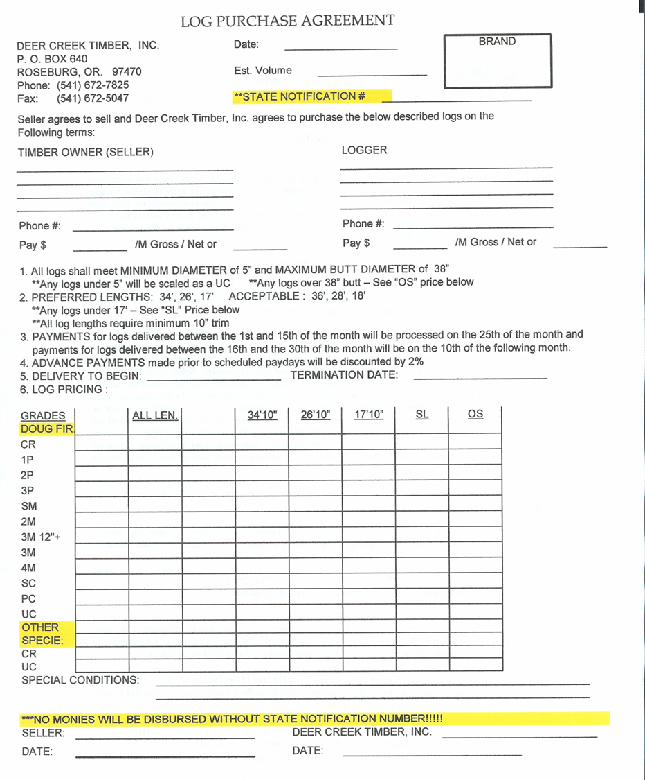
Seal the deal with a purchase order
Example timber company
Address
Phone
Before you cut!
Notes:
Once a log buyer is chosen, they will enter into an agreement with the landowner called a purchase order. The landowner must understand the purchase order, which will describe the log specifications and prices paid for delivered logs. The pay structure is listed on a gross scale, but the landowner and logger are paid for the net volume after the deductions for defect are taken at the mill. Deductions are usually made by a third-party scaler.

Slide 18
About mills
Photo: Lauren Grand, © Oregon State University

Slide 19
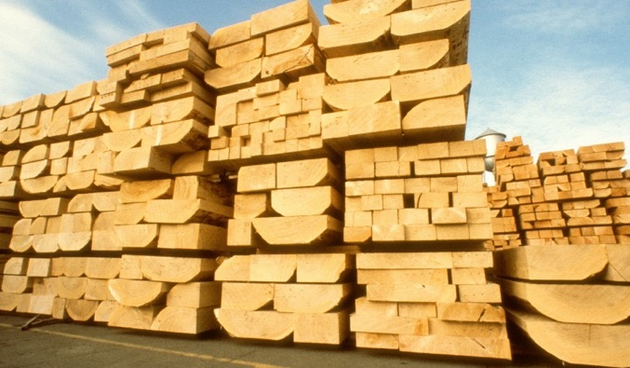
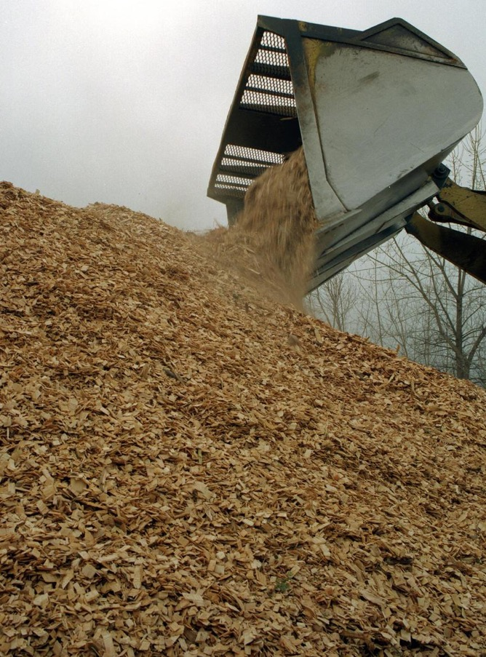
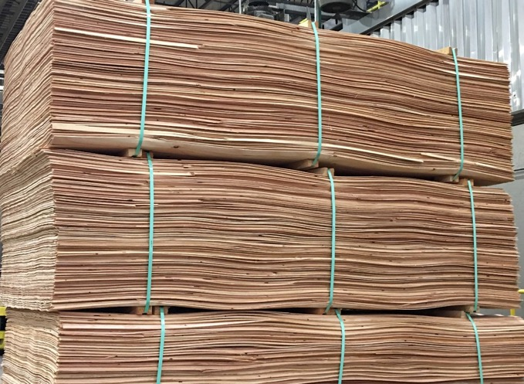
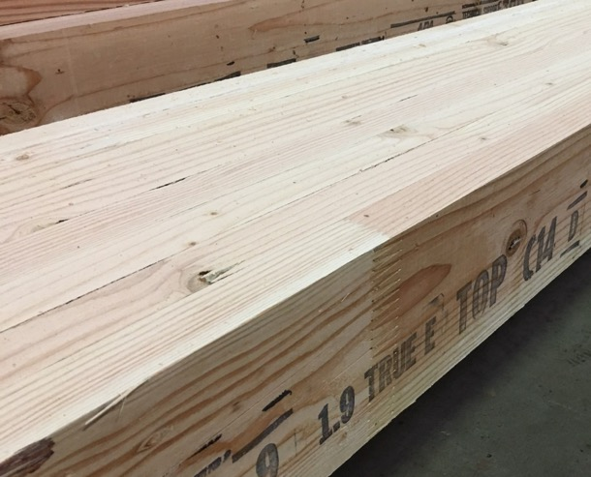
What are they making from the log?
Photo: Lynn Ketchum, © Oregon State University
Photo: Lauren Grand, © Oregon State University
Photo: USDA FS Southern Research Station ,
USDA Forest Service, SRS, Bugwood.org
Photo: Lauren Grand, © Oregon State University
Photo: Lauren Grand, © Oregon State University
Notes:
Sawmills tend to specialize in what they manufacture from the logs they purchase. This increases efficiency and dictates the specifications in the logs they purchase. Some examples include specialty products such as cross arms, timbers, shingles and shakes.
Types of mills include:
Timber mills
Stud mills
Dimension mills
Peeler mills
Board mills
Chips
Utility poles
Fenceposts
Export
Hardwoods
Specialty
Sort yards

Slide 20
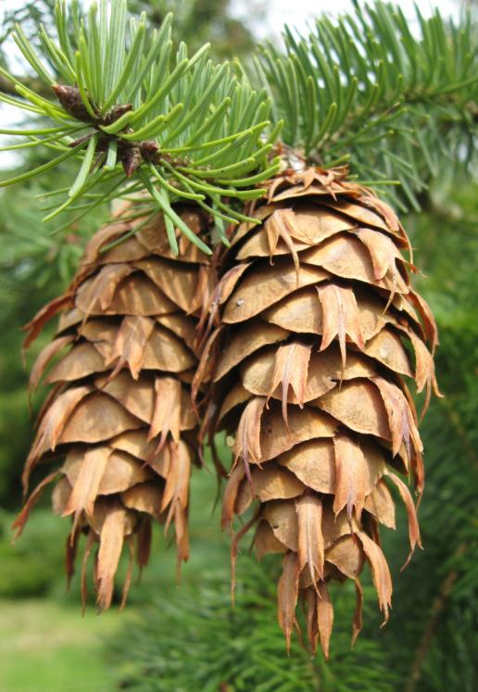
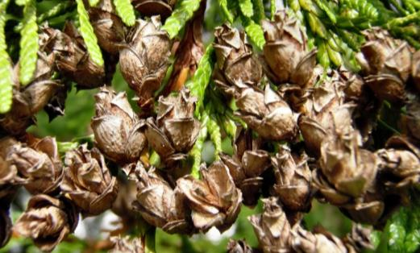
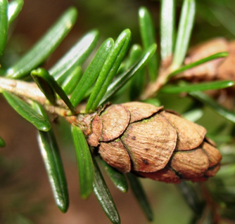
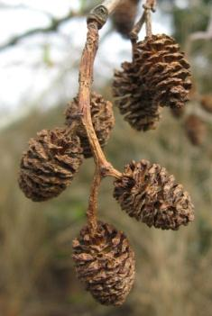
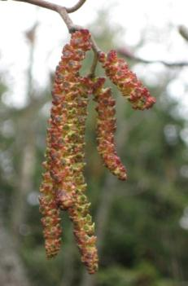
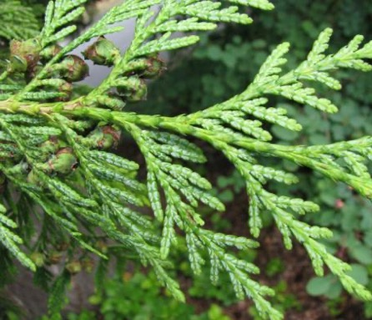
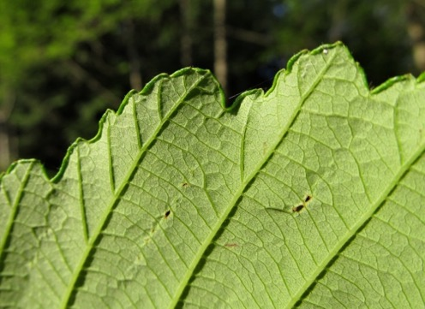
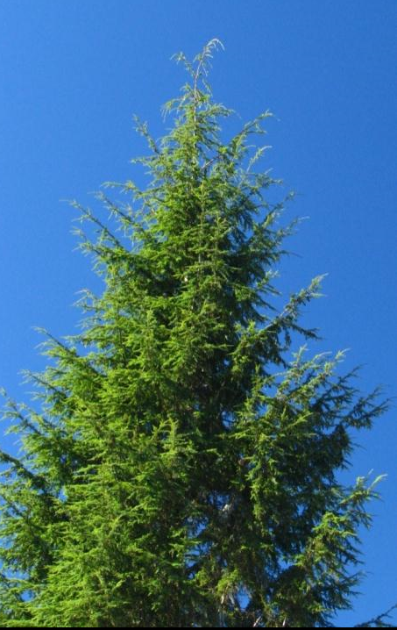
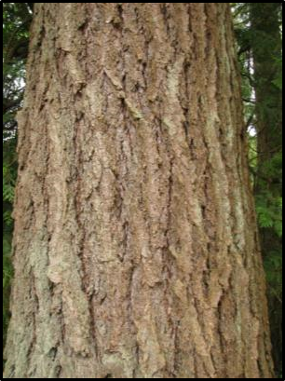
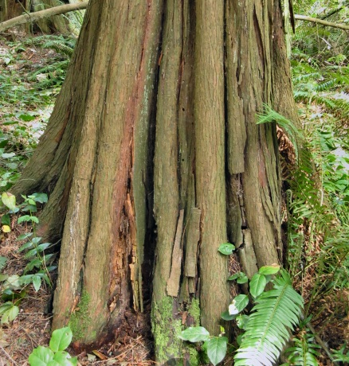
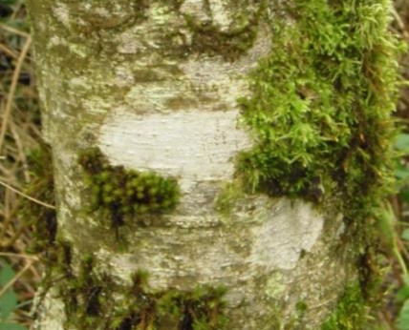
Species
Photos: Kevin Zobrist, Washington State University
matters
Douglas-fir
Western
redcedar
Western
hemlock
Red alder
Notes:
Mills can be specific to a species or species group. Conifers and hardwoods are rarely taken at the same mill. Sort yards are log yards that are not typically associated with a mill. They typically purchase mixed loads of logs and sort them in their yard for resale to the appropriate mills. This model allows them to take a wide range of species and sizes. This can be helpful for a small landowner who is selling a small amount of logs with a large variety in species and sizes.

Slide 21
Sawmill technology can limit what a buyer is interested in
Photo: Lauren Grand, © Oregon State University
Notes:
The firm that purchases your logs has physical limitations on the size (diameter and length) of the logs they can use. For example, a ring debarker is limited by the diameter of the opening. What kind of technology the mill uses to cut the debarked log has limits as well. Circular saws are limited by the diameter of the blade. Band saws have an opening limit.

Slide 22
Local products
Notes:
Edit the following slides to match some examples of what options exist in your area. You may consider including some common specifications if applicable.

Slide 23
Softwood lumber
Photo: Lauren Grand, © Oregon State University

Slide 24
Firewood
Photo: Steve Bowers, © Oregon State University
Notes:
Sold by the cord

Slide 25
Pulp
Photo: Lauren Grand, © Oregon State University
Notes:
Sold by weight
Requires a weigh scale

Slide 26
Specialty products – utility poles
Photo: Lauren Grand, © Oregon State University

Slide 27
Dimension lumber
Photo: Lauren Grand, © Oregon State University

Slide 28
Plywood
Photo: Lauren Grand, © Oregon State University

Slide 29
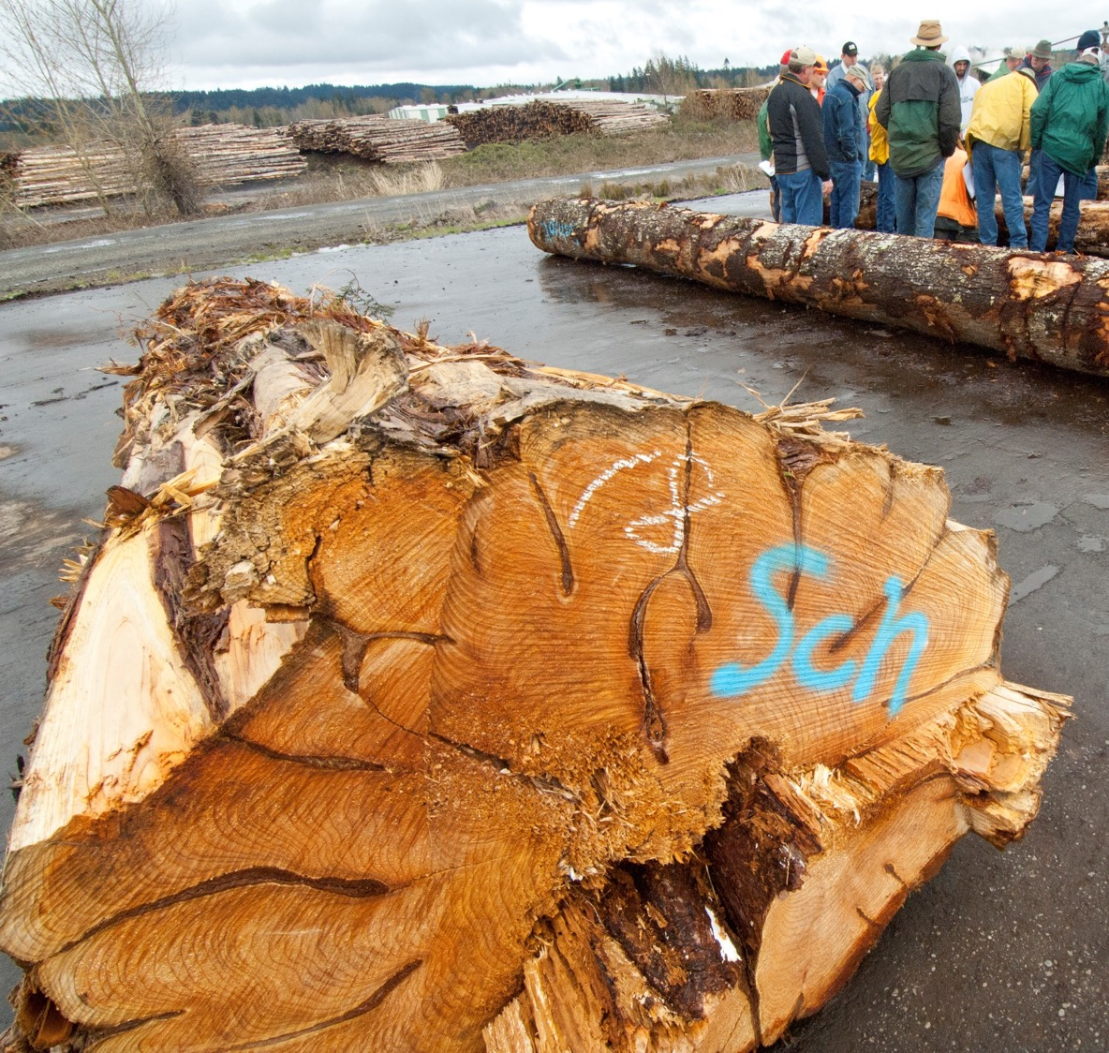
Export
Japan sort
High quality Douglas-fir
China sort
Low quality Douglas-fir
Ponderosa pine
White woods
Photo: Lynn Ketchum, © Oregon State University

Slide 30
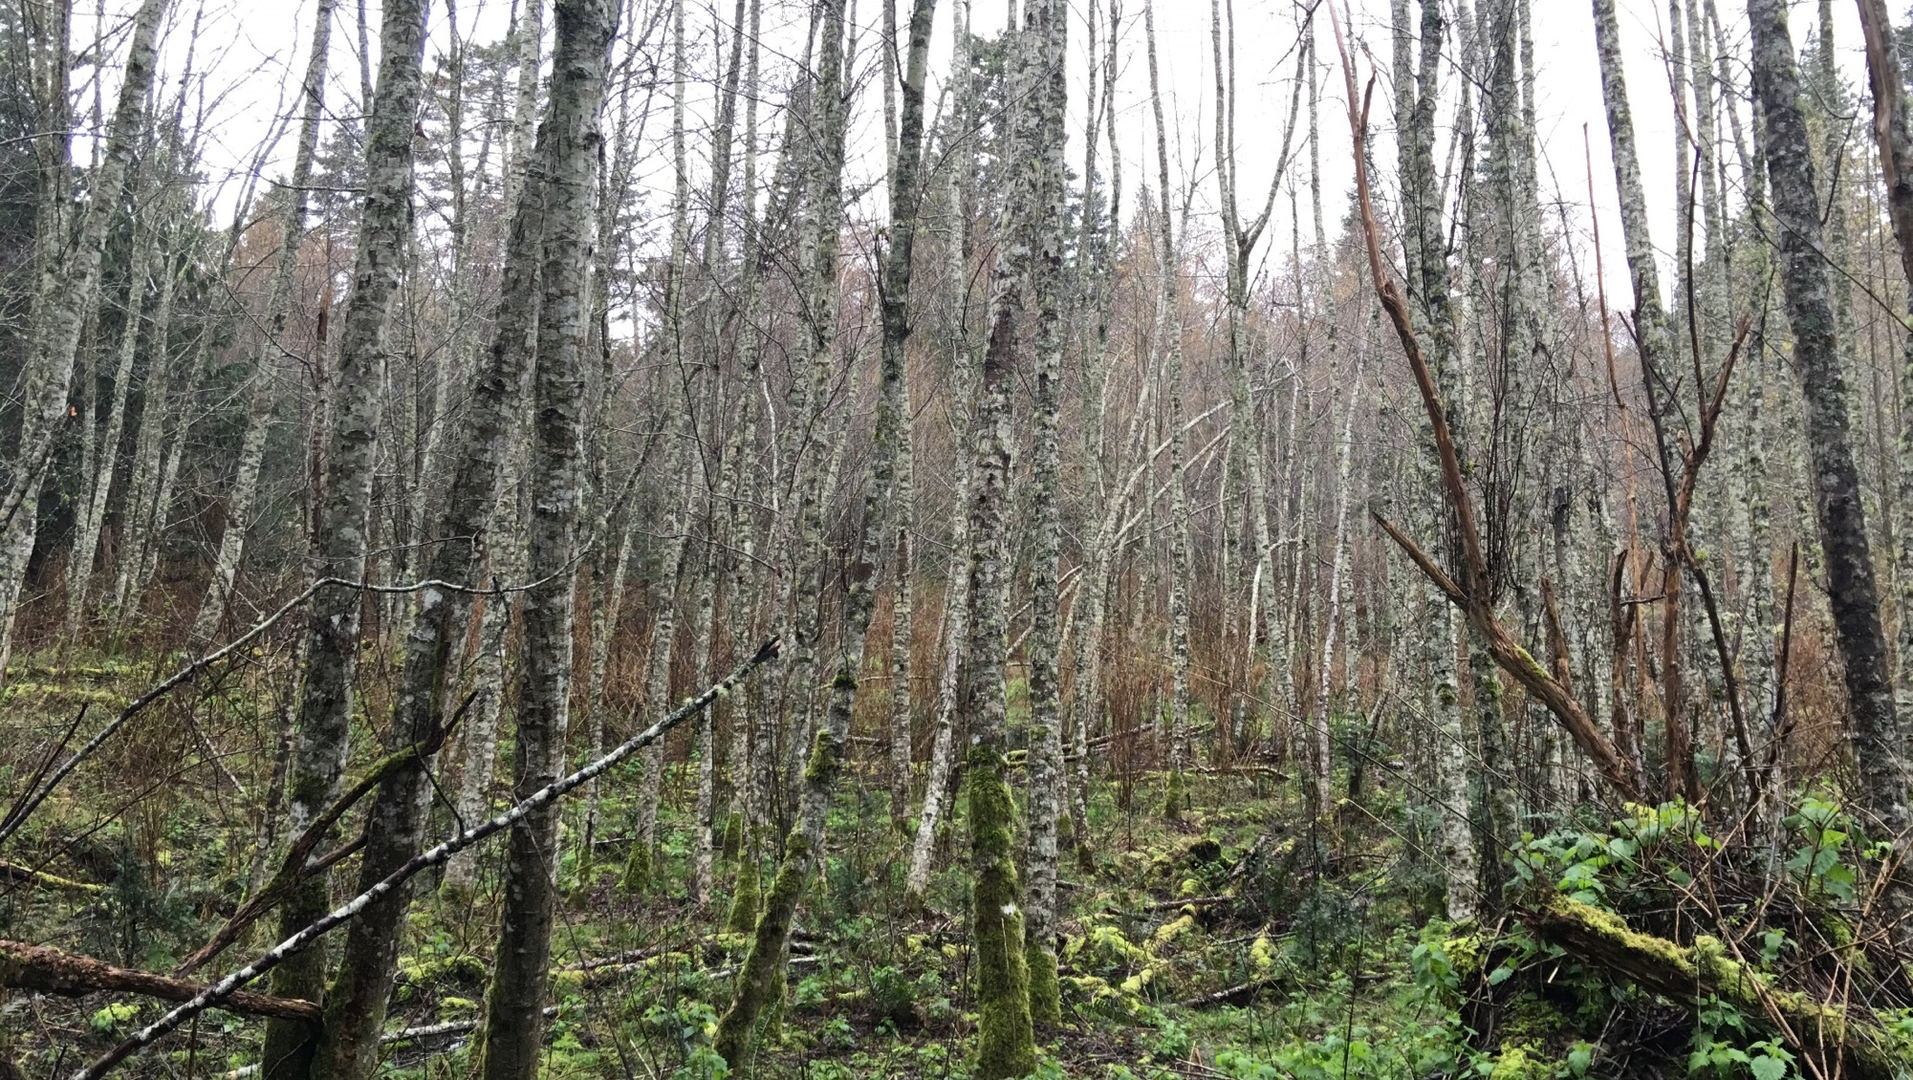
Hardwoods
Photo: Lauren Grand, © Oregon State University
Notes:
Hardwood pulp logs are purchased by the ton, as with other species. But sawlogs can either be purchased by the ton or per thousand board foot (MBF).

