Slide 1
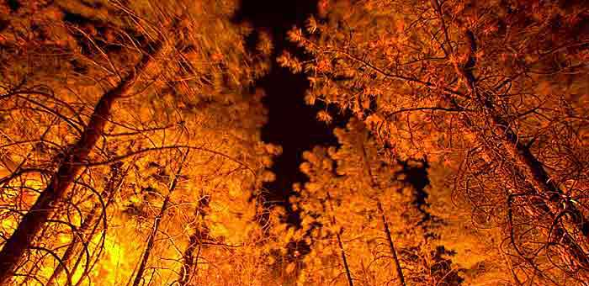
Module 3: Fire Behavior
FIRE SCIENCES CORE CURRICULUM
Notes:
This module provides an in-depth review of the fire behavior triangle and its components - topography, fuels, and weather and the fire tetrahedron for structure fires. Module 2 also goes into a more depth on fire severity, fire intensity, fire spread, types of fire, fire regimes, and potential climate change effects.

Slide 2
LEARNING OBJECTIVES
Understand how weather, topography, and fuels affect fire behavior:
  Create a landscape and ‘matchstick forest’ and hypothesize how a fire will behave.
Understand how fuel size and arrangement contribute to fire spread and fire type
Compare and contrast fire severity and fire intensity
Be able to explain what factors produce or influence fire regimes
Notes:
Read directly from the slide.

Slide 3
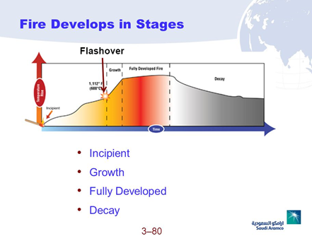
Flashover demonstration: https://www.youtube.com/watch?v=BtMmymOxdjc
Notes:
As background for discussing fire behavior, there are four fire development stages for wildland and structure fires. An important aspect of fire growth, which affects firefighters need to be aware of is, is that of “flashover” which occurs during the rapid growth of the fire. This is particular important for structure firefighters due to petroleum-based fuels within the home that give off volatile gases. Take a look at this narrated video showing flashover in a typical room containing furniture.

Slide 4
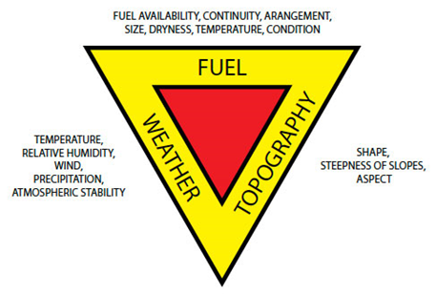
THE FIRE BEHAVIOR TRIANGLE
Notes:
You’ve already learned about the fire triangle and what it is comprises of: fuel, heat sources, and oxygen. Take away or eliminate one factor and the fire goes out. In this module, we want to build on that and discuss the Fire Behavior Triangle and the Fire Tetrahedron, which applies to structure fires.
Let’s begin first with the fire behavior triangle. The fire behavior triangle has three sides: fuels, topography, and weather. If one of these elements change during the course of a wildfire, the behavior of the fire changes, often times very rapidly. We will examine each of these factors in more detail.

Slide 5
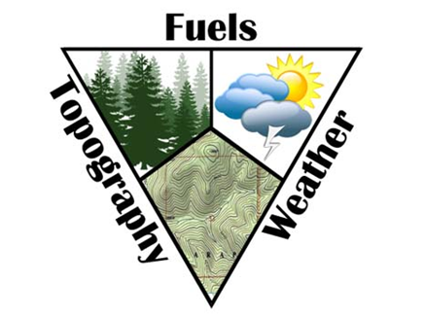
THE FIRE BEHAVIOR TRIANGLE
What do we mean by fire behavior? What
does it include?
Terminology Meaning
Rate of spread How fast a fire moves in ft./min. or chains/hr.
Intensity How hot a fire burns (heat released in BTUs)
Flame length Surrogate measure for fire intensity
Torching Flames moving up from the surface into tree crowns
Crowning Flames spreading through the main tree canopy
Spotting Spot fires ignited by embers ahead of main fire front
Whirlwinds Superheated air and turbulent wind conditions form whirling eddies of fire
Notes:
So what do we mean by fire behavior? Essentially, it is the reaction of a fire to changes in the fire’s surroundings (fuel, weather, and topography). It is reflected in the following “behaviors”: rate-of-spread, intensity, flame length, torching, crowning, spotting, and the presence of whirlwinds. Read definitions directly off the table.
I will spend more time on some these later in the presentation.

Slide 6
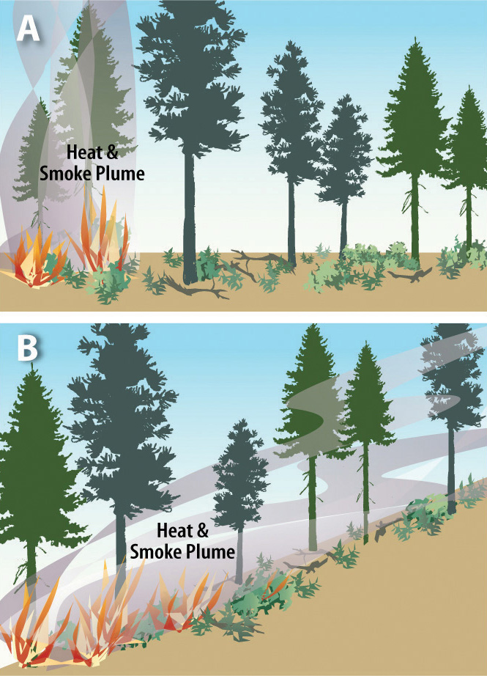
THE FIRE BEHAVIOR TRIANGLE
Topography
Fires spread faster upslope:
  Slope tilted toward the flames
  Fuels more effectively preheated by approaching flames
Notes:
Topography is essentially the “lay of the land.” It includes aspect (direction the slope faces) , slope (steepness) elevation, canyons, mountains, and saddles.
Fires tend to spread faster up slope because flames are closer to the fuels and, thus, are more effectively heated, dried and combusted as the flames spread uphill through the fuel bed.

Slide 7
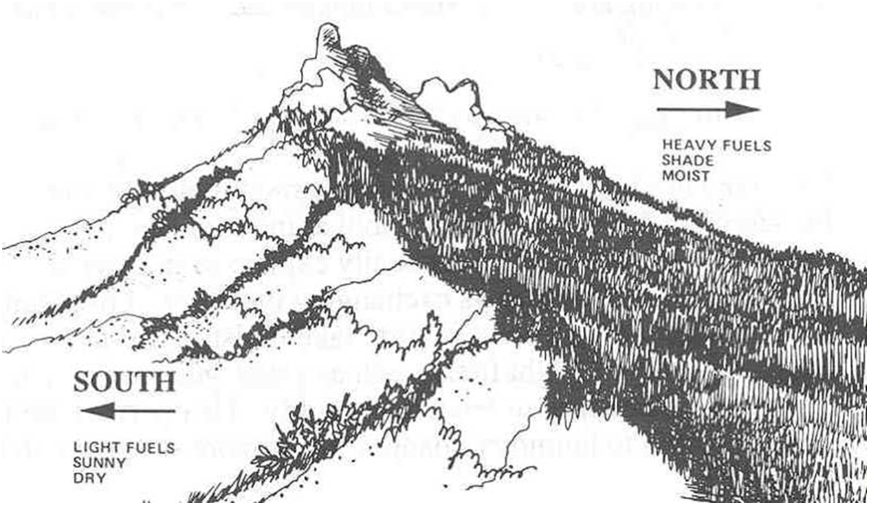
THE FIRE BEHAVIOR TRIANGLE
Topography
Slope angle, aspect, and elevation affects:
  Drying of fuels on a daily and seasonal basis
  Air temperature and temperature of fuels
Notes:
Read directly from the slide

Slide 8
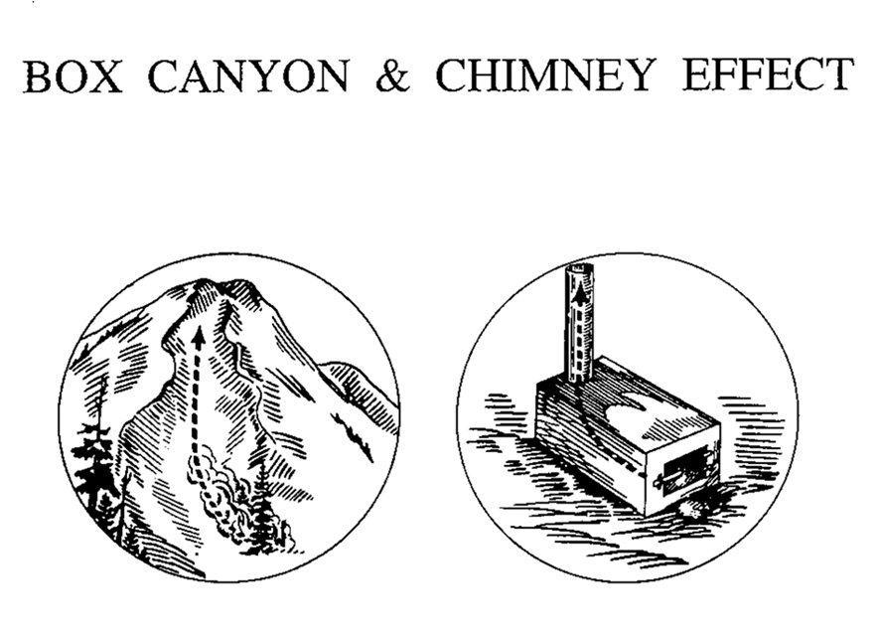
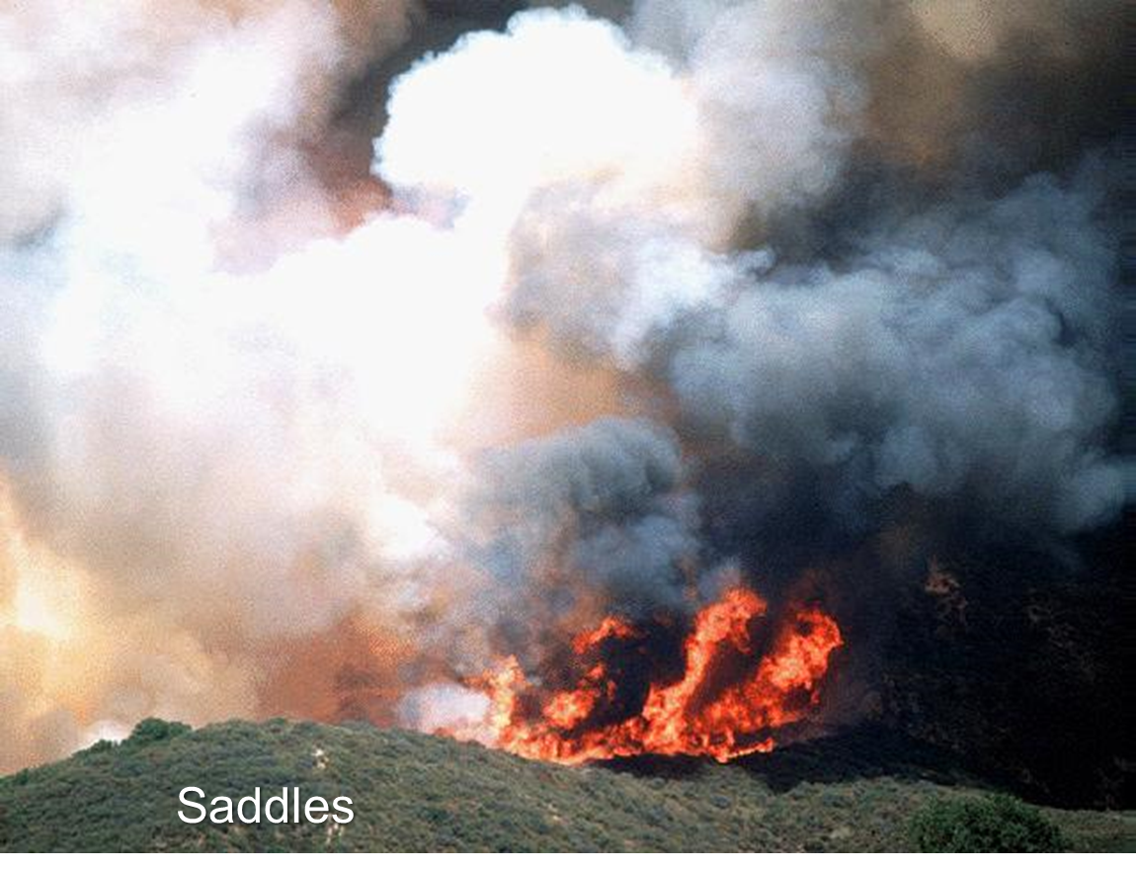
THE FIRE BEHAVIOR TRIANGLE
Topography
Other landscape features
  Box canyons, saddles, narrow canyons affect:
    Air flow and wind currents on a daily basis
    Safety zones for firefighters
Notes:
Read directly from the slide.

Slide 9
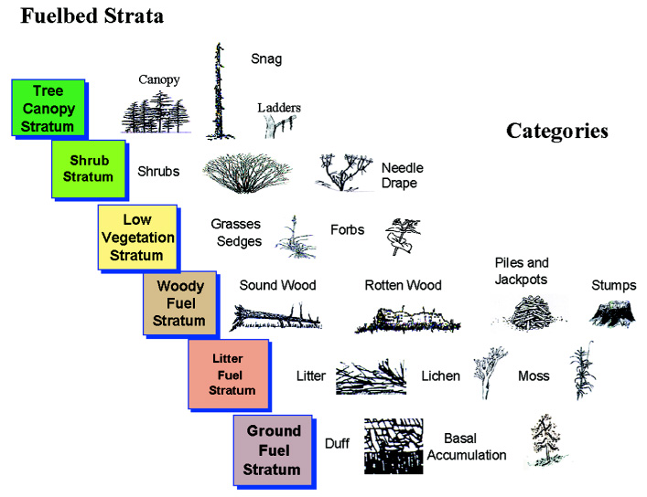
THE FIRE BEHAVIOR TRIANGLE
Fuel
Fuel is anything that will burn under the right conditions!
Fuel continuity:
  Vertical and horizontal dimension to fuels
Natural vs. activity fuels
Notes:
Fuel is anything that will burn under the right conditions. Fuel continuity is the degree degree or extent of continuous or uninterrupted distribution of fuel particles in a fuel bed thus affecting a fire's ability to sustain combustion and spread. This applies to aerial fuels (vertical) as well as surface fuels (horizontal).
The amount of fuel on a sites is know as fuel loading and is measured by tons per acre. In the second photo there is a high fuel loading of slash (activity fuels) from the thinning operation. To reduce the fuel load, slash is usually piled and later burned. If not, fuel loading can remain high well into the future, thus keeping the stand in a high fire risk situation. In Oregon, fire laws require landowners to reduce fuel loading follow harvest operations.

Slide 10
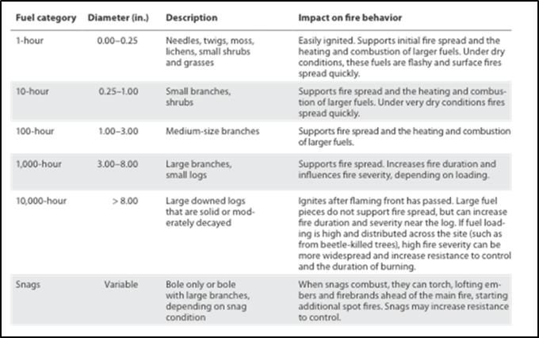
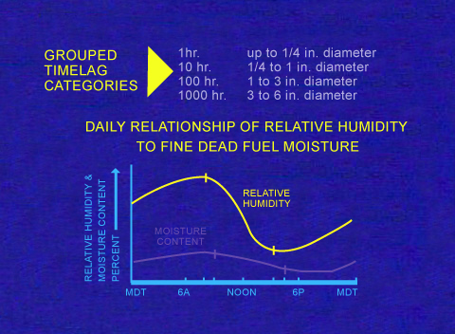
THE FIRE BEHAVIOR TRIANGLE
Fuel
Fuel moisture:
  Live FM
  Dead FM
Fuel size
  Surface-to-volume ratio
Chemical makeup
  Resin, sap, foliar chemicals
Notes:
In order for woody fuels to burn, the moisture contained within the fuel needs to be driven off. This requires heat to vaporize the water. The higher the fuel moisture, the more heat it takes to drive off the water and the more difficult it is for fuels to ignite, sustain combustion and burn. Live fuel moisture is moisture contain in living plants and in tree foliage. Life fuel moisture in tree needles can be over 300% in early summer and decline to 100-150% by August. Dead fuel moisture is the moisture contained in dead needles, branches, logs, and in the litter layer on the forest floor.
How fast dead fuels dry or wet up depends on their surface-to-volume ratio (STV). Fine fuels (needles, dead grass, small twigs) have a high STV ratio and wet up and dry quickly in response to daily weather fluctuations. The opposite is true for larger fuel sizes like logs. Thus fuels can be broken into size categories based on the time it takes for the them to dry or wet up. One-hour fuels react to wetting or dying within an hour; Ten-hour fuels are larger in takes about 10 hours for moisture within them to react to changing weather conditions. There are also 100-hour, 1,000-hour and even 10,000-hour fuels. This table displays the characteristics of these fuel sizes and their contribution to fire behavior. The chemical content of the fuel can also play big role in ease of combustion and fire behavior. Some conifers or hardwood trees, like fir species and Eucalyptus, contain a lot of volatile chemicals in their foliage, increasing the about energy (BTU content) of the fuel.

Slide 11
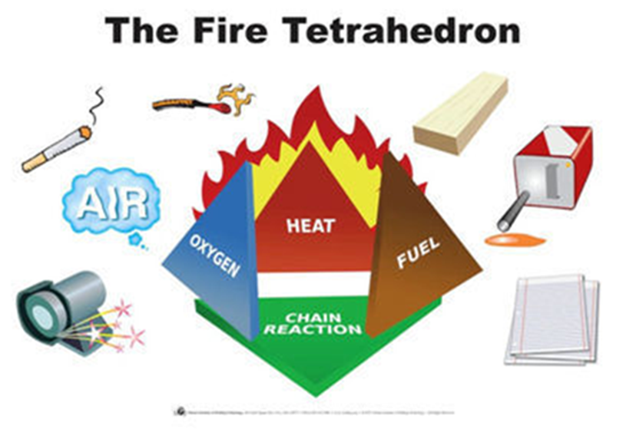
THE FIRE TETRAHEDRON
Structure Fuels
Fire triangle with the added element of a chemical chain reaction
Petroleum-based products used in home construction
Notes:
The fire tetrahedron is the fire triangle with added element of a chemical chain reaction as a result of the multitude of petroleum based products used in home construction and in furniture.

Slide 12
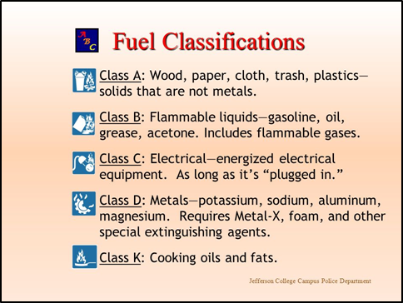
THE FIRE TETRAHEDRON
Structure Fuels
Notes:
Structure fuels are classed A through D and K. Read directly from slide about what each fuel class is comprised of.

Slide 13
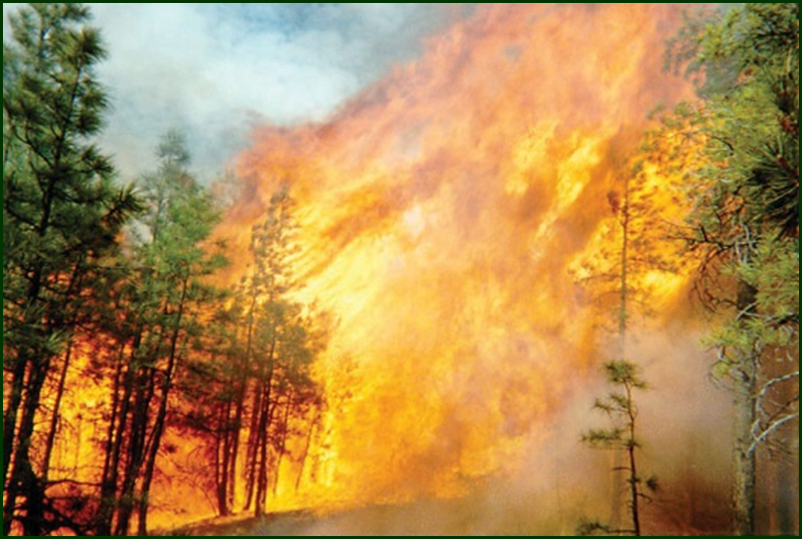
THE FIRE BEHAVIOR TRIANGLE
Weather
Wind
Increases
oxygen supply
Influence
direction of fire
spread.
Dries fuels
Moves air heated by convection into more fuels
Causes spot
fires
Example: Dry east winds are particularly dangerous during August and September in Oregon.
Notes:
Wind can increase the oxygen supply to the fire, dry fuels quicker, and influence the direction and speed of the fire. Think of wind as a billow that can fan the fire. Certain types of wind event are particular dangerous, such as east winds in Oregon and Santa Anna winds down in southern CA.

Slide 14
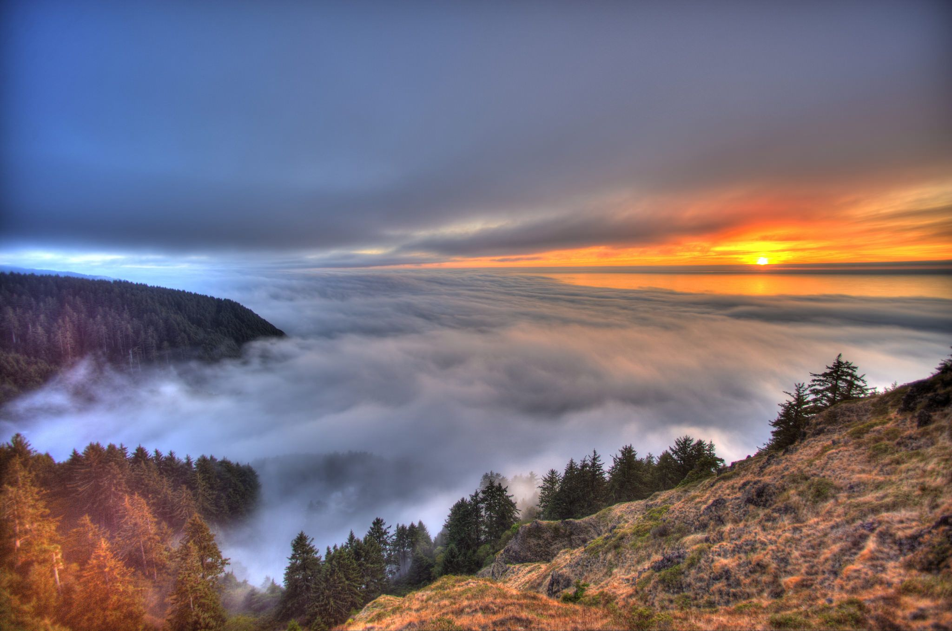
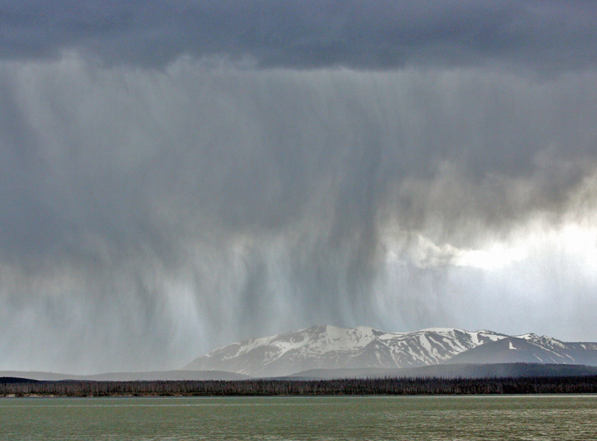
THE FIRE BEHAVIOR TRIANGLE
Weather
Precipitation
Duration
generally has
greater effect
than volume
Precipitation
Pattern of yearly precip. affects fuel drying
Other influences, such as a marine layer, can affect
relative humidity and fog drip and the wetting and drying of fuels.
Notes:
Read directly from slide.

Slide 15
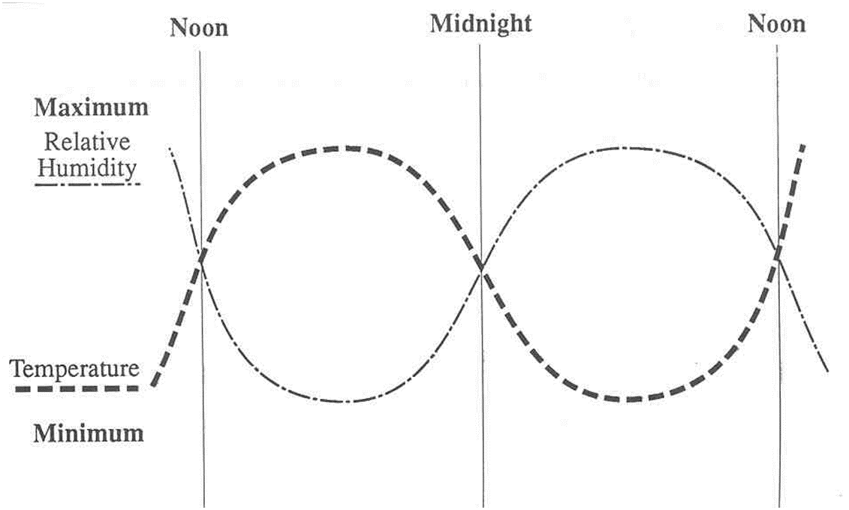
THE FIRE BEHAVIOR TRIANGLE
Weather
Relative Humidity
Affects diurnal wetting and drying of fuel
  Dependent on fuel surface-to-volume ratio
Notes:
On a daily basis, relative humidity affects the wetting and drying of fuels and, therefore, their ability to combust. Fuels tend to be moist in the morning when relative humidity is at it highest. However, by afternoon the relative humidity drops and fuels become dryer. That is why you see much more active fire behavior (smoke column) in the afternoons on a warm day. The speed at which fuel wets up or dries with respect to relatively humidity depends on the fuel particle size (needles/grass vs. large branches).

Slide 16
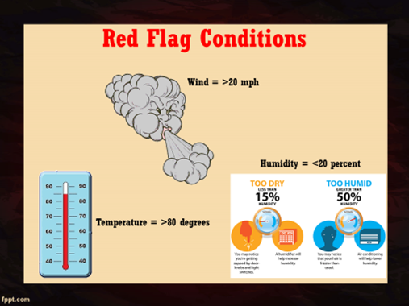
THE FIRE BEHAVIOR TRIANGLE
Weather Extremes
Notes:
Red flag weather conditions are influenced by wind, temperature and humidity. Red flag conditions are considered extremely dangerous as it allows for rapid fire growth and spread. These conditions are extremely hazardous for firefighters and the public.

Slide 17
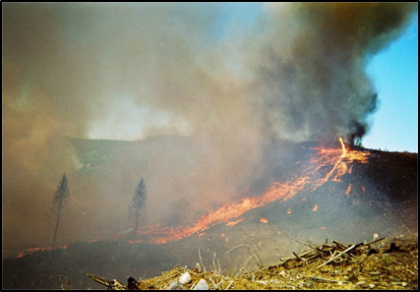
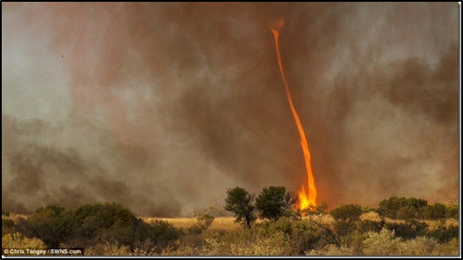
THE FIRE BEHAVIOR TRIANGLE
Weather Extremes
Fire Whirls
Unstable atmosphere
Superheated air plus turbulent wind conditions
Notes:
Fire whirls caused by unstable atmospheric conditions. Fire whirls are a product of superheated air plus turbulent wind conditions.

Slide 18
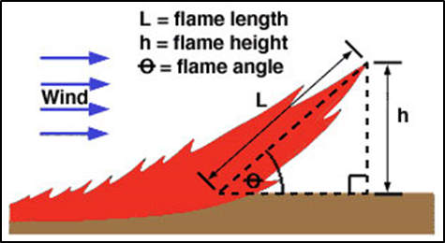
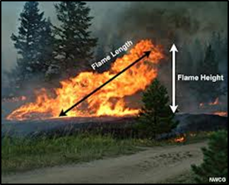
FIRE INTENSITY AND FIRE SEVERITY
Fire Intensity or “Fireline Intensity”
I = 258 FLˆ2.17
I = energy release (Btu) per unit length (ft.) of fire line per unit time (seconds)
FL = flame length (ft.)
Measure at the midpoint of the flame
Can be easily observed with proper reference point
Notes:
Fire intensity and fire severity are not the same, although they are often and mistakenly used interchangeably.
Fire intensity is the rate of energy release per unit of time per unit of length of the fire front. It is a product of available fuel energy and the fire’s rate of advance. The higher a fire’s intensity is, the more difficult it is to suppress it and the greater the potential for negative affects to soils and vegetation.
Flame length is measured at the midpoint of the flame (see photo) and can observed with a proper reference point.

Slide 19
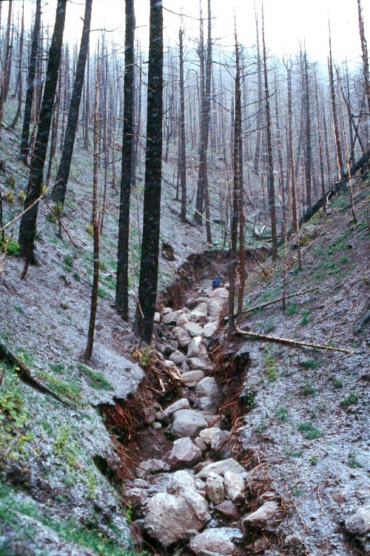
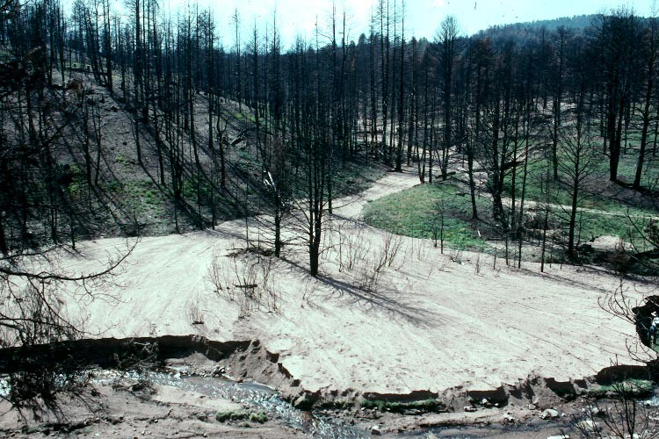
FIRE INTENSITY AND FIRE SEVERITY
Fire Severity
Refers to the effects of a fire on the environment:
  Damage to vegetation and trees
  Damage to soils and watersheds
Notes:
Read directly from the slide.

Slide 20
FIRE INTENSITY AND FIRE SEVERITY
Fire Severity
Fire severity is rated as low, moderate and high base on visual fire effects to soil or vegetation. Example below for soil.
Notes:
Fire can create tremendous change to soil properties, especially in the short term. Reduced canopy interception, water droplet impact to the soil surface, plugging of soil pores from ash, and hydrophobic conditions reduce infiltration increasing the risk of overland flow, erosions, debris flows, and floods.
Loss of forest canopy also changes snow interception, snow melt and changes stream runoff amount and timing as shown from this hydrograph from a burned over watershed on the Entiatt Experimental Forest in north-central Washington.

Slide 21
THE FIRE BEHAVIOR TRIANGLE
Fire Spread
Fire spread is the movement or progression of fire through a fuel bed
It is measured by feet per minute or chains (66 ft.) per hour.
Fire spread is influenced by the type and continuity of fuel, moisture content of fuel, topography, and weather factors, such as wind.
Notes:
Read directly from the slide.

Slide 22
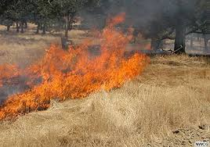
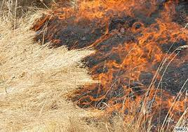
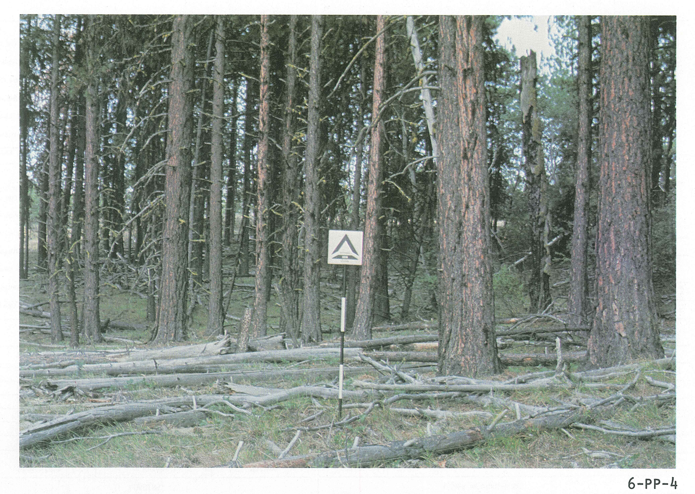
FIRE SPREAD
Fire Spread
Fuel Type Rate of spread
Grass and bitterbrush (2-GR) 46 chains/hr. (3,036 ft.)
Ponderosa pine/bitterbrush (4-PP-4) 9 chains/hr. (594 ft.)
Dense ponderosa pine/heavy surf. fuels (6-PP-4) 5 chains/hr. (330 ft.)
Head fire in grass with rapid spread
Backing fire in grass with slow spread
Dense PP with heavy surface fuels
Adapted from: USDA Forest Service GTR PNW-105
Notes:
Here is a table illustrating fire spread in different kinds of fuels. Note that wind direction can play a role in fire spread creating or pushing a head fire versus a fire burning into the wind, such as a back fire. Backing fires progress at a much slower rate than a head fire. These fuel models shown in the table (and in the far right photo) are published fuel models and are used to predict fire behavior.

Slide 23
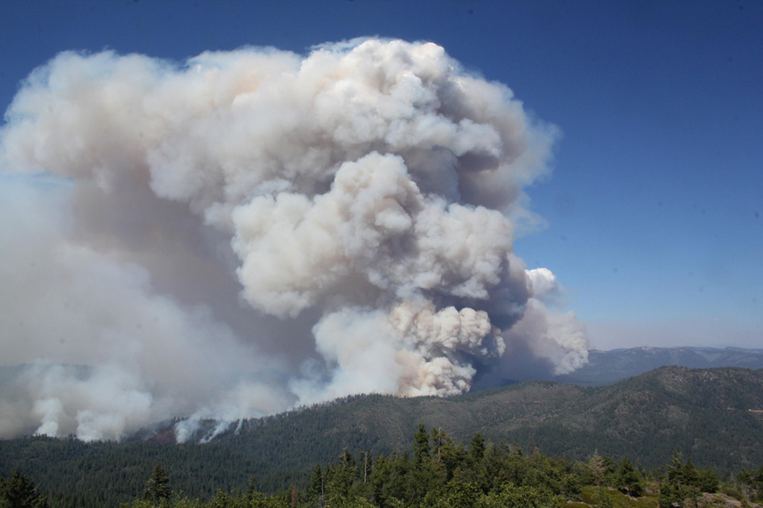
FIRE TYPES
Ground fires
Surface fires
Crown fires
  Passive
  Active
Notes:
Let’s now talk about fire types: ground, surface and crown fires. Crown fires can be both passive and active.

Slide 24
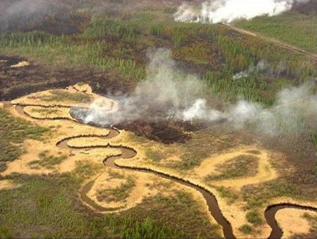
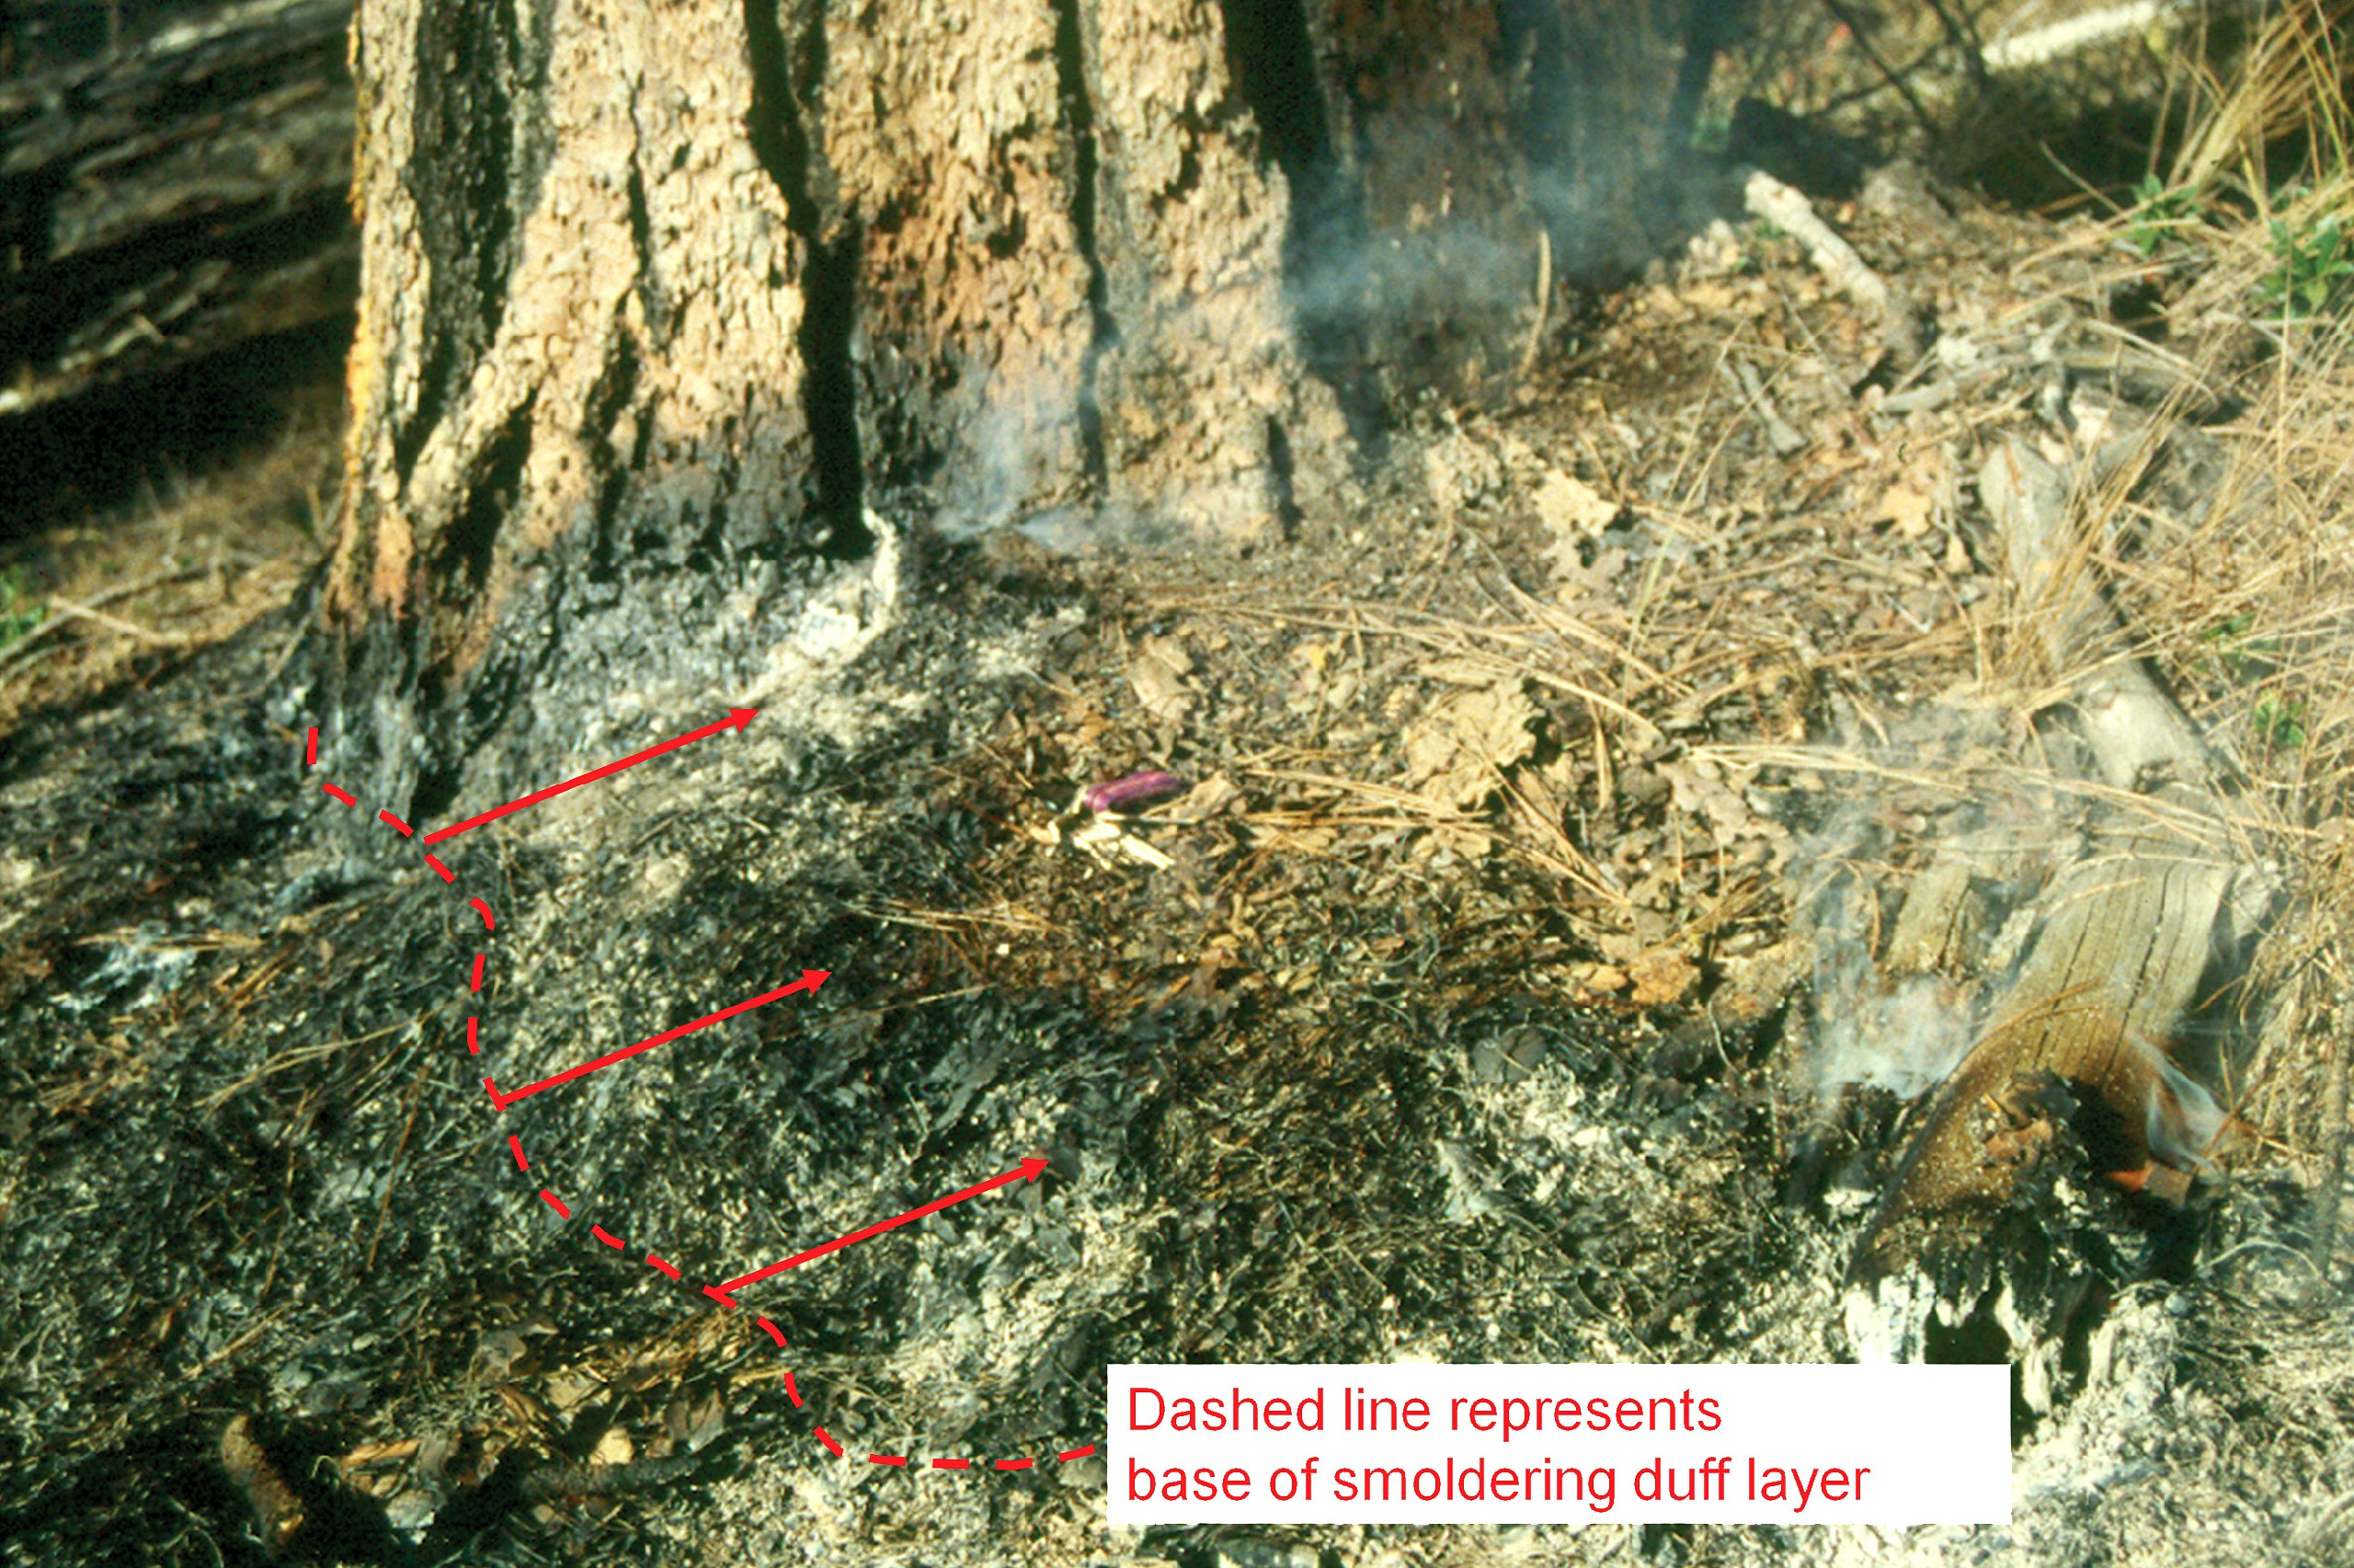
FIRE TYPES
Ground fires
Burn below the surface in duff, roots, buried logs, and peat
  Peat fires:
    Slow rate of spread
    Long duration, high severity
    Peat fires can last for years
    Difficult to extinguish
  Burning in duff around large ponderosa pine trees
    Long duration smoldering fire
    Tree mortality
Notes:
Read from the slide. Add your own thoughts or examples.

Slide 25
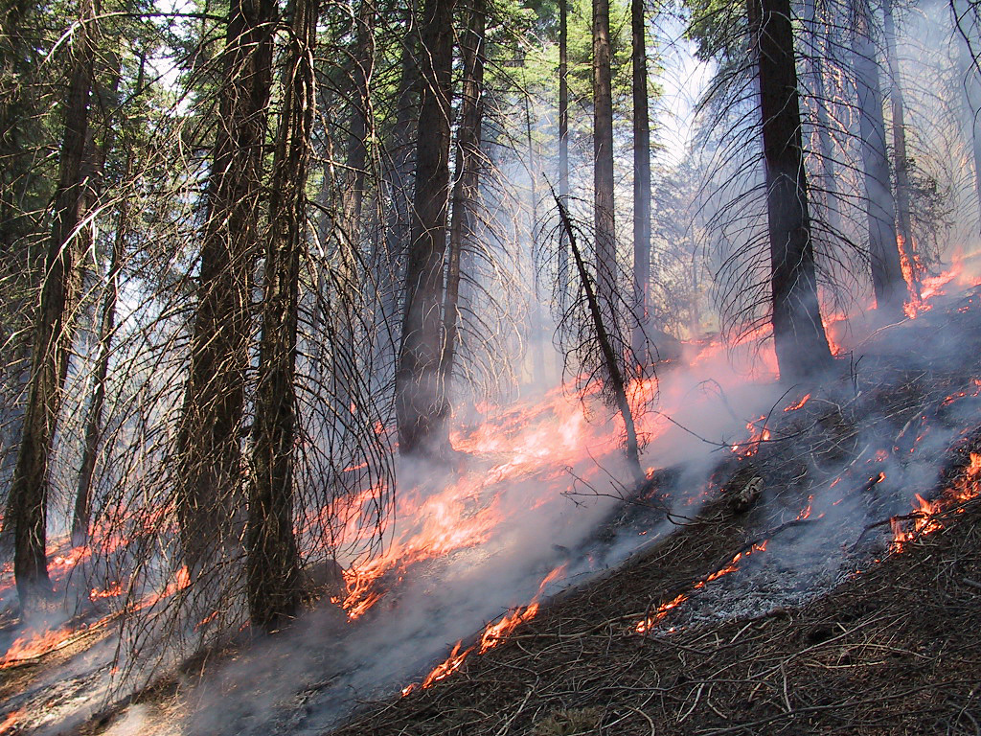
FIRE TYPES
Surface fires
Consume litter layer, herbaceous vegetation, shrubs, twigs, and branches
The higher the fuel loading on the surface, the greater the flame length and the greater the intensity of the fire
Notes:
Read from slide.

Slide 26
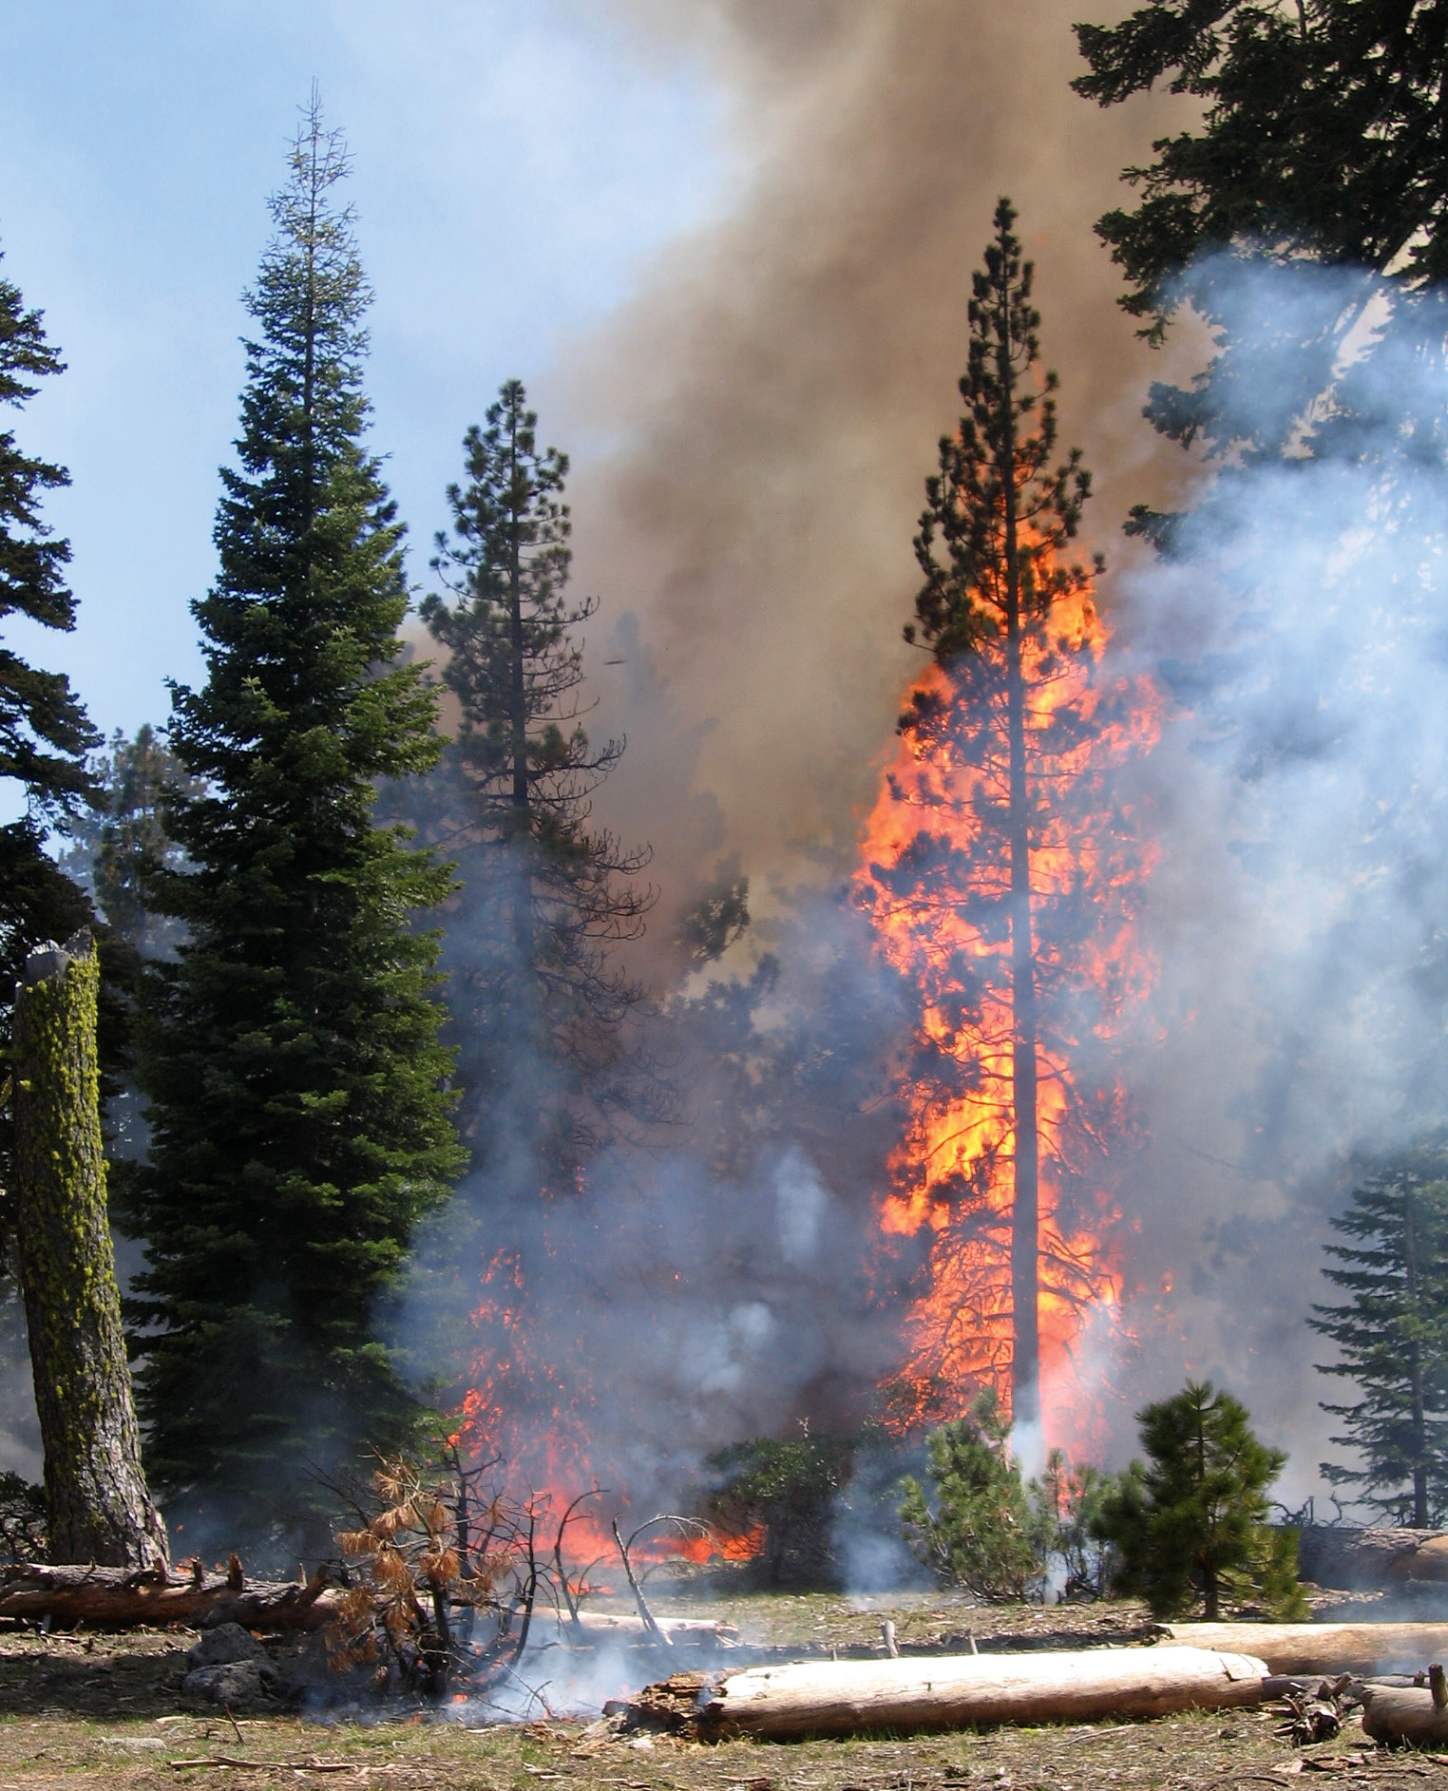
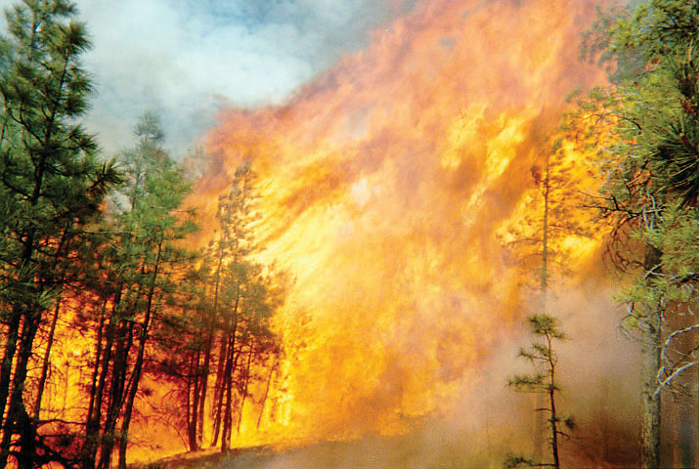
FIRE TYPES
Crown fires:
Passive
  “Torching” of individual trees or small groups of trees
Active
  Crown-to-crown combustion
Notes:
There are two types of crown fires: passive and active. Passive crown fires occur when a surface ascends up (with the help of ladder fuels) into the canopy of one or multiple trees. This is known as “torching.” After the trees torch, the fire descends back to a surface fire. This can process can occur multiple times in a given fire.
An active crown fire is one where a surface fire ascends up into the canopy and then initiates crown-to-crown combustion moving through the canopy. Each combusting crown preheats and ignites the next tree crown in progression. The ability of a crown fire to remain and move through the canopy is dependent on the amount of surface fuel and heat generated when it is combusted (flame length) and on topography and wind. Wind is a big factor in sustaining active crown fires.

Slide 27
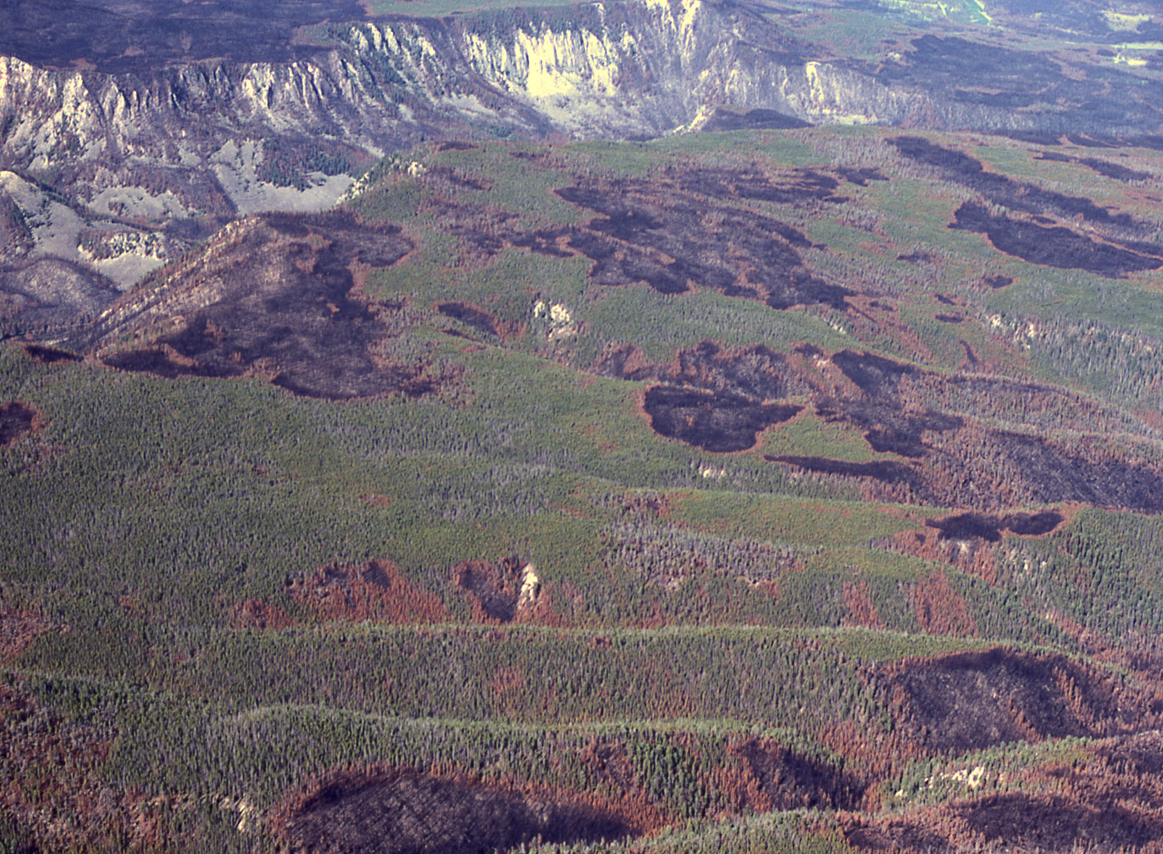
FIRE REGIMES
Describe the predominant types of fire in ecosystems.
Fire regimes have the following elements:
  Frequency
  Fire intensity and severity
  Extent
  Seasonality
  Synchrony/synergy with other disturbances
Vegetation, climate, and topography are factors that determine the fire regime in a given area.
Notes:
The term “fire regime” describes the type of fire that historically grass, rangeland, and forest ecosystems experienced during their development. Read the rest from the slide.

Slide 28
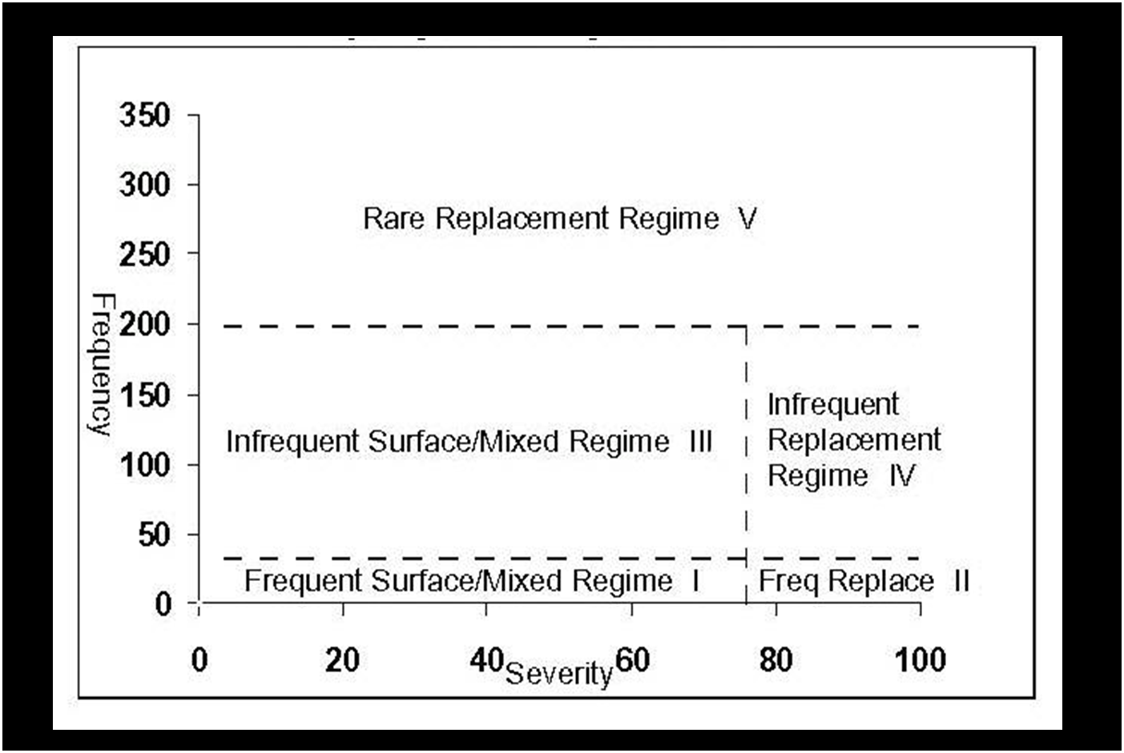
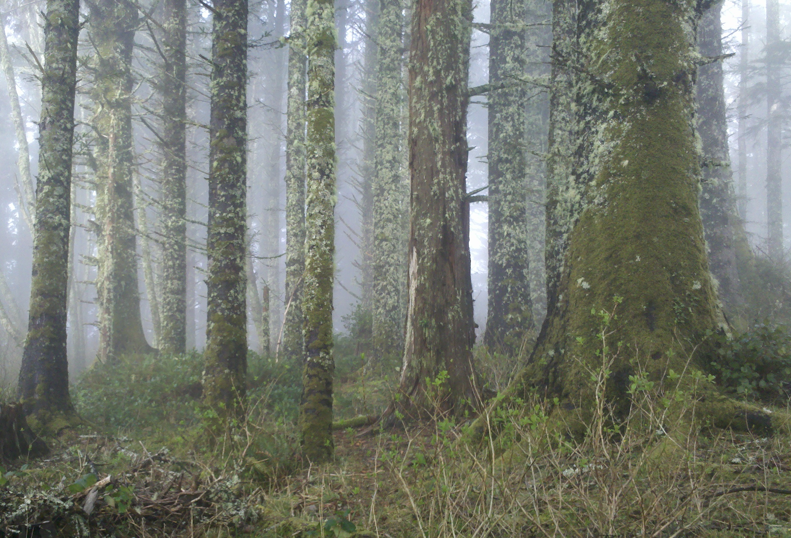
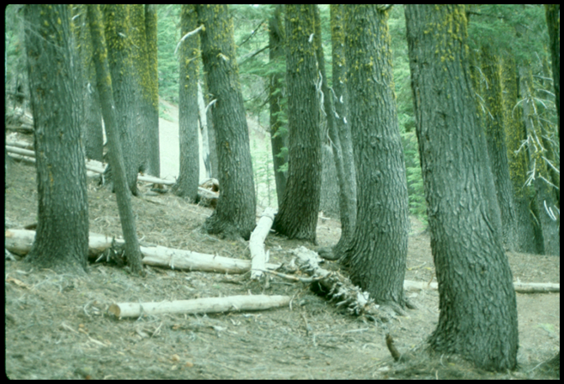
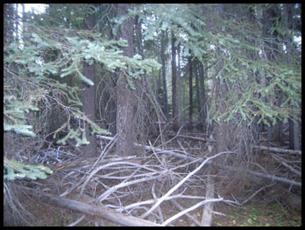
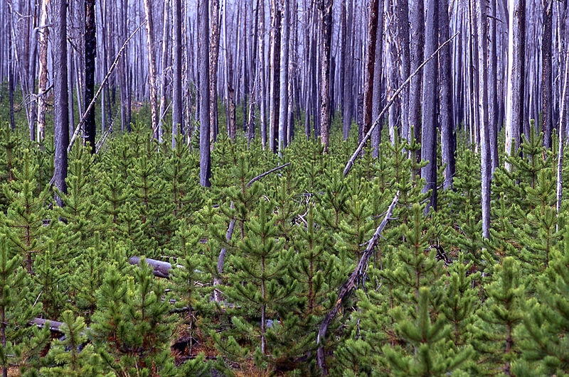
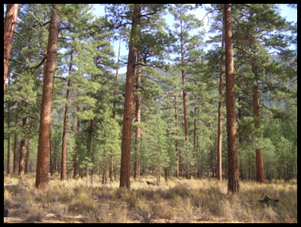
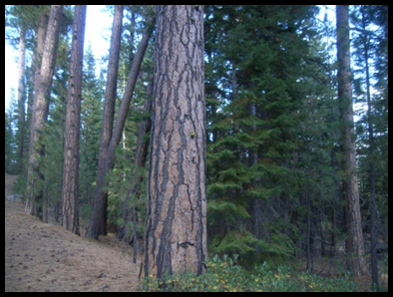
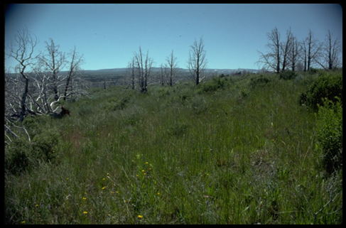
FIRE REGIMES
Characterizing fire regimes by frequency and severity
Notes:
Fire regimes can be characterized in the following manner base on frequency and the degree of stand replacement:
Rare Replacement Regime V: Left photo-Sitka spruce (OR fog belt forests);
Right photo-Mountain hemlock (OR Cascades)
Infrequent Replacement Regime IV: Right photo-Lodgepole seedlings under burned trees
Infrequent Surface/Mixed Regime III: Left photo-Moist mixed conifer forests
Frequent Replacement Regime II: Right photo – Range and grasslands
Frequent Surface/Mixed Regime I Left photo-Ponderosa pine forests
Middle photo-Dry mixed conifer forests

Slide 29
POTENTIAL CLIMATE CHANGE EFFECTS
CO₂ levels have risen to over 400 ppm and global temperatures are 1.53ºF higher than in early industrial times.
Fire seasons are about 5 weeks longer today, with an uptick in very large wildfires across the western U.S.
Implications for plant ecology, human infrastructure, and fire suppression tactics and costs.
Notes:
Read off the slide.

Slide 30
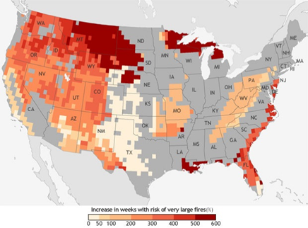
POTENTIAL CLIMATE CHANGE EFFECTS
The projected percentage increase in the number of “very large fire weeks” by mid-century (2042-2070) compared to recent past (1971-2000). (NOAA)
Notes:
Read the slide. Point out the scale as the bottom of the map.

Slide 31
POTENTIAL CLIMATE CHANGE EFFECTS
In addition to climate change potential, other factors that may contribute to very large wildfires now and into the future include:
  Effects of fire exclusion over the last 100+ years and the build-up of fuel in many of the dry forest types in the western U.S.
  Changes to firefighting tactics. More conservative fire management approaches will err on firefighter safety rather direct attack at all cost.
  There is a growing sentiment that in order to get ahead of the wildfire problem, we need to allow wildfires to do more of the work (fuel reduction) by managing wildfires.
Notes:
Read the slide. Add your own thoughts and experience on this issue.

Slide 32
This concludes this module training.
Thank you!

