Slide 1
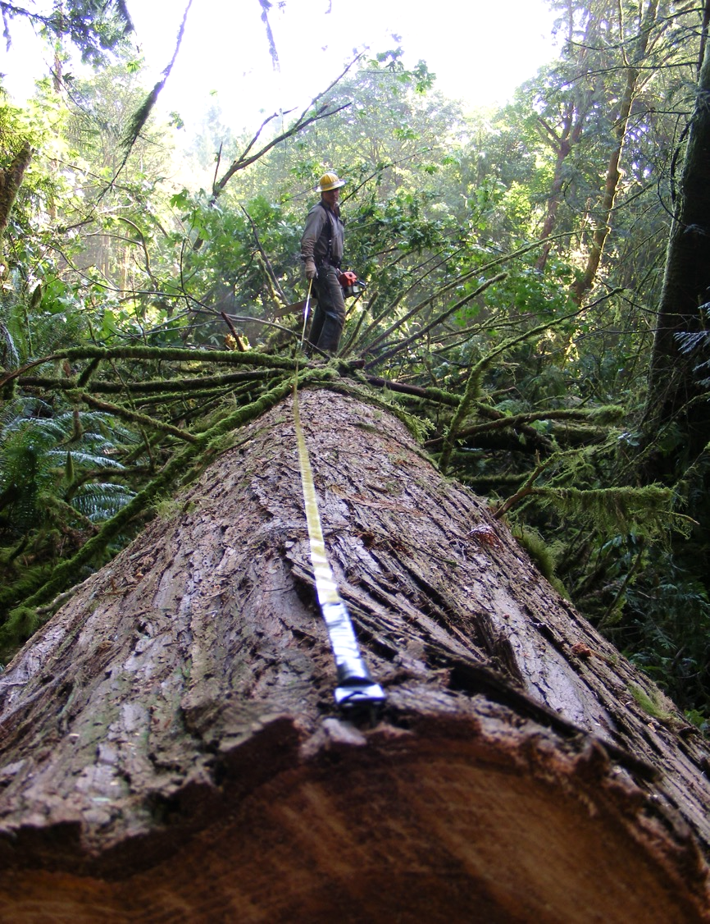
Timber sale fundamentals
Presentation prepared by: Francisca Belart, timber harvesting specialist, Oregon State University
Photo: Francisca Belart, © Oregon State University

Slide 2
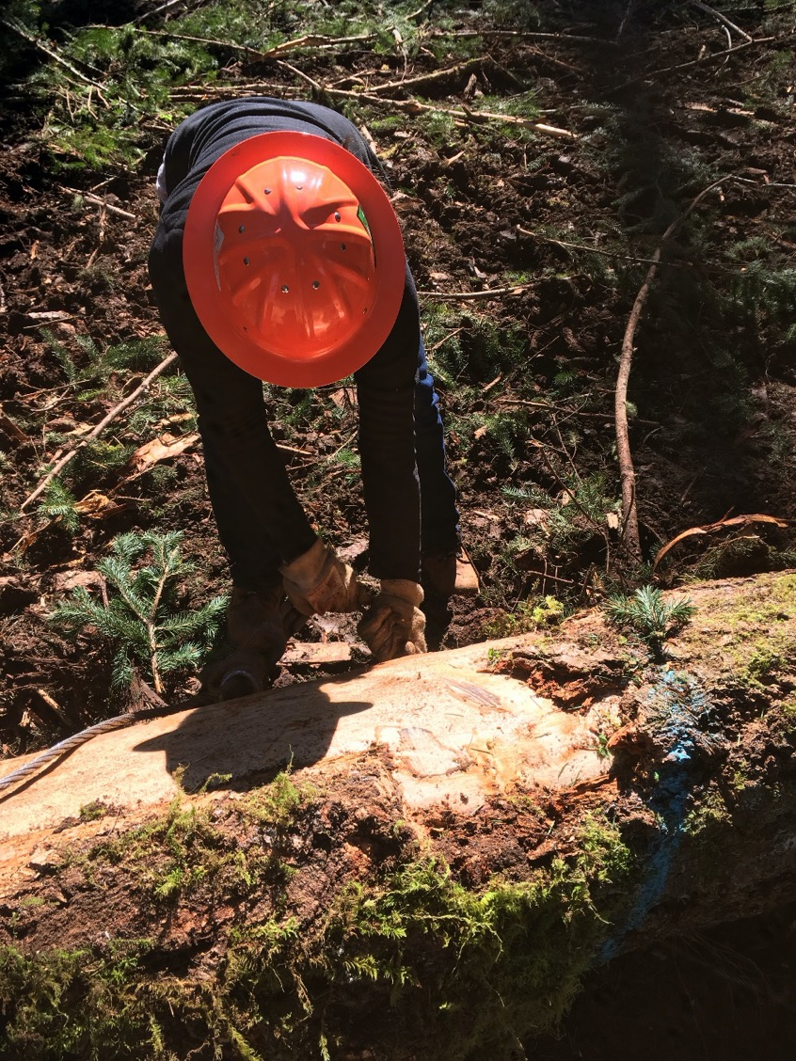
Overview
Planning
Economic viability
Steps of a timber sale
Roads
Photo: Steve Bowers, © Oregon State University
Notes:
Timber marketing success relies on an understanding of local timber products, a good estimate of what a landowner has for sale, an understanding of yearly market fluctuations and trends, and competition between buyers for the products offered.

Slide 3
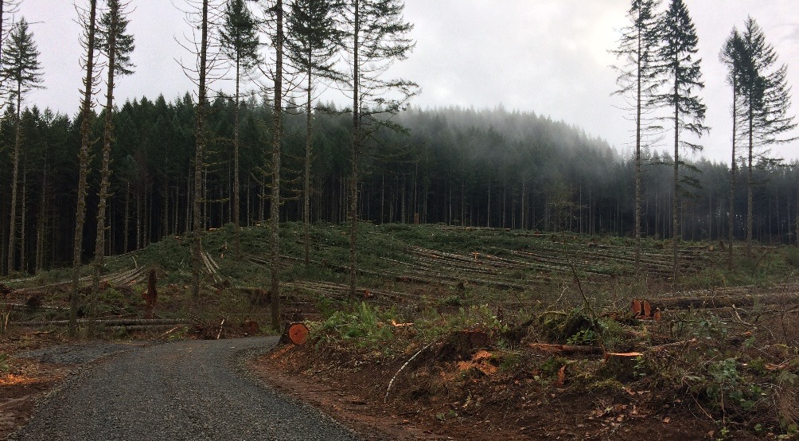
Planning
Management plan:
- What are your objectives?
- Maps!
Timing: Season affects technical, economic feasibility
Access: roads, landings, skid trails
Property lines, easements
Seedlings!
Photo: Francisca Belart, © Oregon State University
Notes:
Timber harvesting is a tool used to reach management objectives. A successful sale takes planning. Consider economics, timing, log markets and road access (rock). Talk about the big picture; consider harvesting as part of a vision and an objective for the property owner.

Slide 4
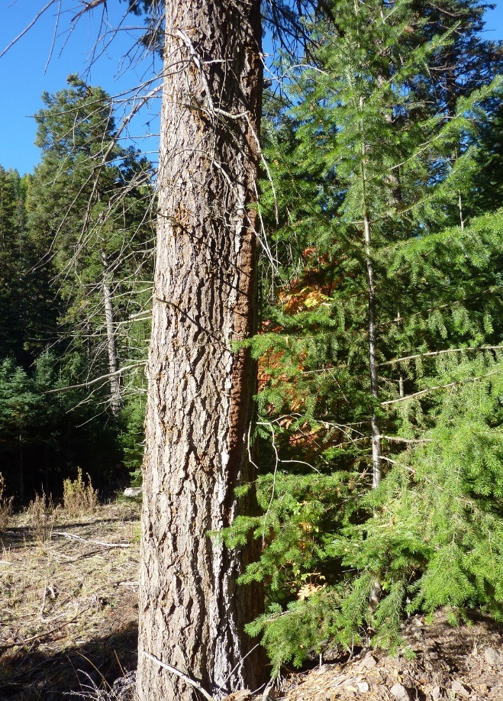
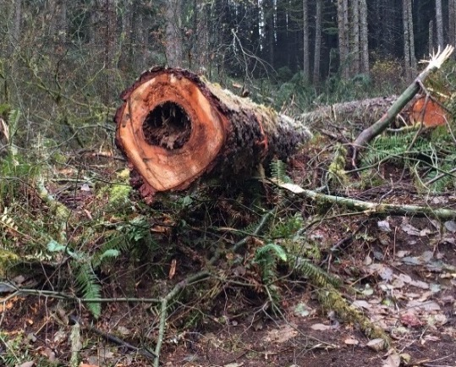
Economic viability
Snow damage?
No thanks!
Will depend on:
Stand characteristics
  Volume removed
  Tree size
  Tree quality
Topography
  Logging equipment
  Productivity
Photos: Francisca Belart, © Oregon State University
Notes:
Mention that small acreage or poor quality logs usually do not make money. Steep terrain entails lower productivity and challenges and will make the operation less profitable compared with easy terrain. A one-truckload operation is not a money maker.

Slide 5
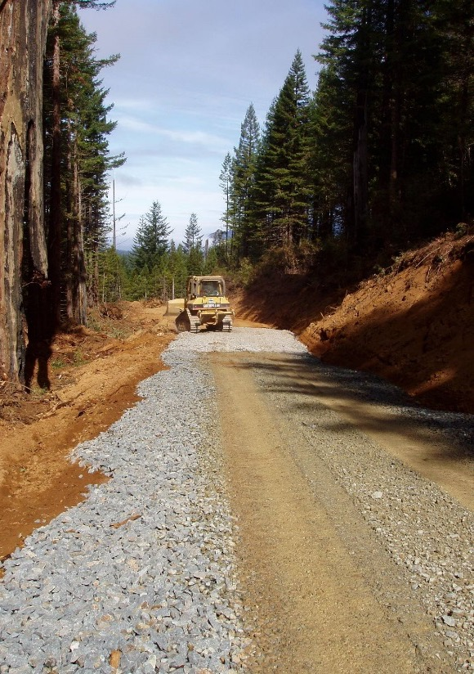
Economic viability
Access
  Obstacles
  Road building/maintenance
Log markets
Type of prescription
(clearcut vs thinning)
Distance to the mill
Photo: Steve Bowers, © Oregon State University
Notes:
Heavy investment in road maintenance or road-building will make the operation less profitable in the short term. But over the long run, these investments can increase your options for harvesting in wet weather. Your operation can also become less profitable if log markets are down, thinning produces a low volume of wood, or if the distance to the mill is extremely far. (You’ll have to add the transportation cost.)

Slide 6
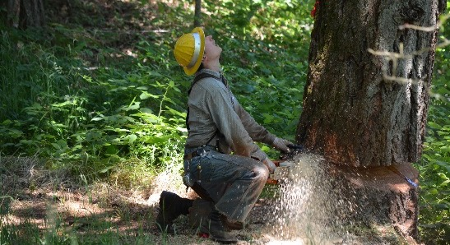
Steps in a timber sale
Notification of operations
Ensure proper access
Identify what’s on your property
Choose stumpage or log sale
Identify potential buyers
Photo: Francisca Belart, © Oregon State University
Notes:
Edit for your region. Mention all steps and that this presentation will walk them through the steps. Notification of operations should be performed first; this step is mandatory.

Slide 7
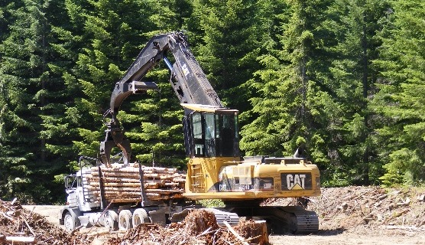

Steps in a timber sale
6. Hire logger or contractor(s)
7. Evaluate offers and select a buyer
8. Monitor the sale (pre- and post-)
9. Determine tax liability
Photos: Francisca Belart, © Oregon State University
Notes:
Timber marketing success relies on an understanding of local timber products, a good estimate of what a landowner has for sale, an understanding of yearly market fluctuations and trends, and competition between buyers for the products offered.

Slide 8
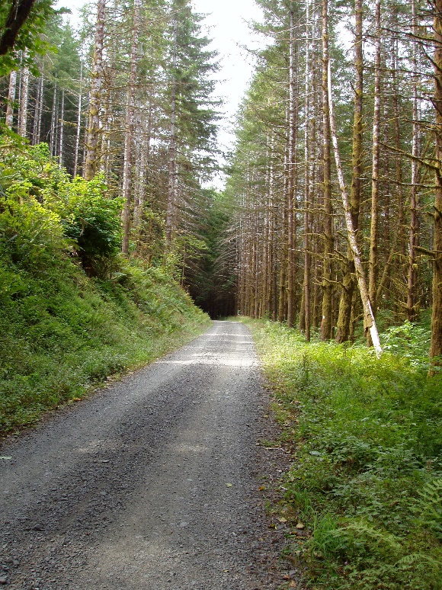
Property access
Easement
  Road use agreement
  Legal description
  Stated time of duration
  Compliance with existing laws
  Stipulations for use
  Waiver of legal responsibilities
  Insurance
  Method of payment
Photo: Steve Bowers, © Oregon State University
Contracts for Woodland Owners: EC 1192
Notes:
Landowners should ensure they have an easement, or road use agreement, in place if hauling through another’s property. List what landowners should have in their easement: road use agreement, legal description, stated time of duration, compliance with existing laws, stipulations for use, waiver of legal responsibilities, insurance (vehicle, liability and property damage), method of payment (lump sum, $/MBF, maintenance). See Contracts for Woodland Owners, EC 1192, catalog.extension.oregonstate.edu/ec1192.

Slide 9
Timber cruising
  Intensity based on stand and objectives
  Estimate volume by grade and species
  Estimate value by grade and species
  Consulting forester specialty
  Expertise needed in defect and grade
  $50-$70/hr, $400-$600/day or $/job
  You can do it
Notes:
In order to negotiate with the log buyer and hire a logger, it is important to estimate how much volume is expected. The accuracy will depend on landowner preference and whether they want to pay a professional. In the case of a stumpage sale, a professional cruise is likely necessary. The value of timber can be estimated by using the volume from the cruise and current market prices for logs. Explain that a tarif system can result in a less accurate inventory of their timber resource if they choose to do it themselves. A tarif system is more appropriate for a mill (log) sale.

Slide 10
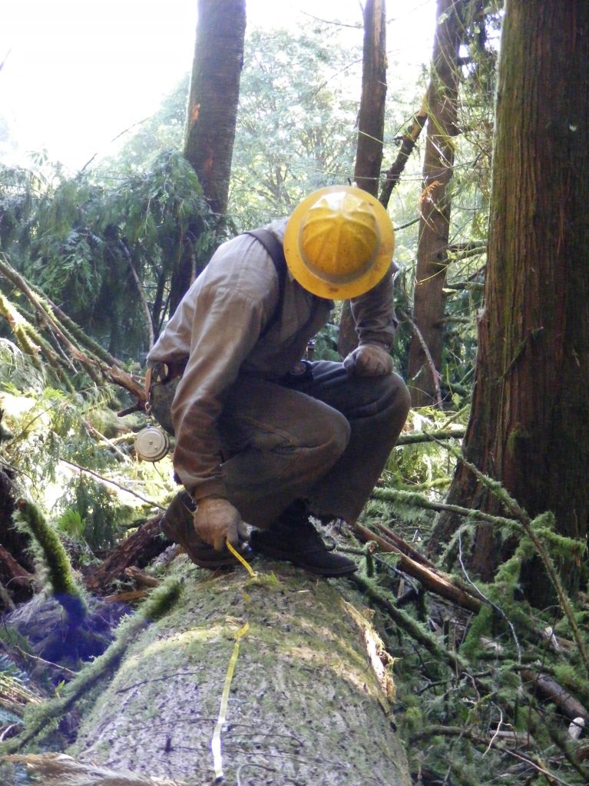
Types of timber sales
Stumpage: a party buys the standing timber. Wood is paid on actual volume removed (scale out) or a predetermined volume (lump sum).
Mill sale: logs sold directly to a mill. Wood is paid on net scale basis.
Photo: Francisca Belart, © Oregon State University
Notes:
Explain two concepts: selling the standing timber or logs.

Slide 11
Timber versus log sales
Stumpage sales
Relatively easy to administer
Minimum marketing skill
Encourages removal of all timber (lump sum)
Accurate cruise required (lump sum)
Mill sales
Maximum value
Ability to “play the market”
Landowner determines logger
Marketing skill required
Requires additional time to manage
Notes:
Explain the advantages and disadvantages of both types of sales. Mill sales give the landowner more control in the aspect of hiring the logger, marketing the timber and overseeing the entire operation. Stumpage sales give the risk and profit to the buyer, but the landowner does not have to manage the sale.

Slide 12
Timber versus log sales
Stumpage sales
Monitoring required (scale out)
Fixed price throughout contract
Buyer determines logger
Profit and risk factor goes to buyer
Option of timber deed
Mill sales
Monitoring required
Ability to modify operations vis written contract (if applicable)
Option to cease operations
Profit and risk factor goes to you
Possible variability in log values
Notes:
Explain the advantages and disadvantages of both types of sales. Mill sales give the landowner more control in the aspect of hiring the logger, marketing the timber and overseeing the entire operation. Stumpage sales give the risk and profit to the buyer, but the landowner does not have to manage the sale.

Slide 13
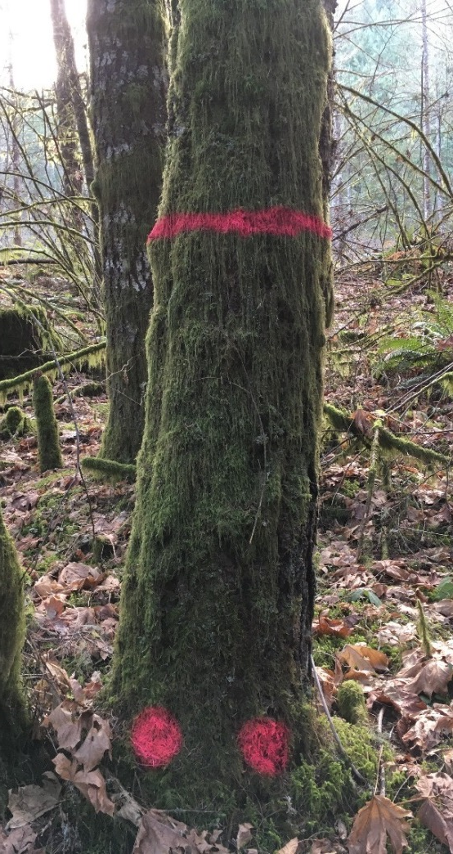
Sale preparation
  Locate and mark boundaries
  Property lines
    Do you need a licensed surveyor?
  Do you have access to the trees?
  Feasibility of operation
    Space for equipment, landings
  Mark trees with paint
  Make sure they are YOUR trees
Photo: Francisca Belart, © Oregon State University
Notes:
It’s very important here to remind landowners to make sure they have clear property lines and that they know which trees are theirs and which are their neighbor’s. If not, have a survey done prior to harvest. Try to make a deal with your neighbor to split the cost.

Slide 14

Selecting a log buyer
Contact at least three log buyers
Explain what you have in your property, have them visit your property if possible
Match timber characteristics to buyer specifications
… YOUR logs meet BUYER product lines
Create a working relationship with a local log buyer.
Shop around, but don’t overdo it
How far is the mill?
Photo: Francisca Belart, © Oregon State University
Notes:
Audience should understand that the better their timber matches the sawmill product line, the better the price they will get. Remember, you might be selling wood to several mills that have different diameter and length requirements for their logs. The sawmill will pay more for trees that can get them the best recovery ($). Having a timber cruise and marking the trees ahead of time will help the log buyer to assess what you are planning to sell and reduce the uncertainty as to what will show up at the mill.

Slide 15
Log buyer directory
Company Name • Facility type
Species purchased
Facility Address, log buyer phone • Log buyer name
Westcoast fir • Sort Yard
Douglas-fir, whitewood, cedars
Eugene, 541-444-5555 • Jeanne Anderson
H - O Lumber Co. • Mill
Douglas-fir
Monroe, 541-444-3333 • Nathan Smith
Bros Forest Products • Sort yard
Douglas-fir
Newberg, 503-888-5555 • Doug Jones
Notes:
On this slide, replace our directory with your own and refer participants to its location in the folder. Explain that the directory is a compilation of primary log manufacturers (lumber, veneer and fiber operations) and sort yards (export and domestic). If you have left any resource out, such as special wood products (exotic species or portable mills), let them know. Share any other resource for local buyers. For example, Oregon has an online Forest Industries Directory at www.orforestdirectory.com. Explain what information they can find and how often they should request a revision.

Slide 16
Oregon annual timber harvest
Woodland owners produce only a small percentage of the harvest.
That means they are price takers.
~3-19%
Source: ODF, Timber Harvest Data 1942-2015
Notes:
Overview of the timber market. Small woodland owners are not large enough to move price trends. So, they are price takers, meaning they need to follow whatever the market is doing. This is governed by industry moves, market demands, tariffs and policy.

Slide 17
Frequency of months with the highest and lowest prices for Douglas-fir
Notes:
This graph shows the amount of times a specific month has had the highest prices (green) and the lowest prices (orange). This shows that the best prices usually happen between March and May. The worst time to sell is summer (August) — mostly because everybody has road access in summer, and there are tons of logs in the sawmill log yard.

Slide 18
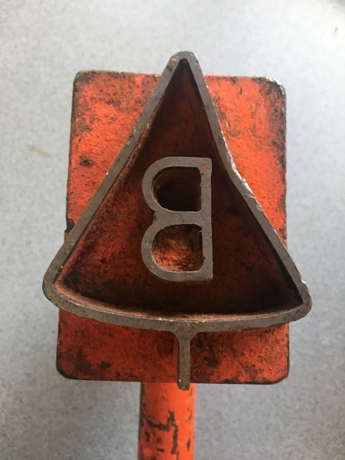
Oregon City/Molalla market, Sept 2018
DF Chips $ 38/ton
(Molalla)
Douglas fir (export, Longview) J $965-860/MBF
Domestic #2 $775-770/MBF
8”-11” $775-770/MBF
Whitewoods (export, Longview) $725-590/MBF
Domestic #2 $660-600/MBF
Redcedar to WA $1235/MBF
Alder Longview 12” $900/MBF
6” $540/MBF
Maple $450-400/MBF
Source: John Lindberg, Oregon Log Market Report
Photo: Brent Klumph, © Oregon State University
Notes:
Local market prices a month before the class. Edit for your region.

Slide 19
Oregon City/Molalla market, Oct 2018
DF Chips $ 38/ton
(Molalla)
Douglas fir (export, Longview) J $965-860/MBF
Domestic #2 $670-650/MBF
8”-11” $670-650/MBF
Whitewoods (export, Longview) $725-590/MBF
Domestic #2 $570-500/MBF
Redcedar to WA $1250/MBF
Alder Longview 12” $825/MBF
6” $540/MBF
Maple $450-400/MBF
Source: John Lindberg, Oregon Log Market Report
Photo: Brent Klumph, © Oregon State University
Notes:
Local market the month of the class. Highlight the ones that have changed in price. Edit for your region.

Slide 20
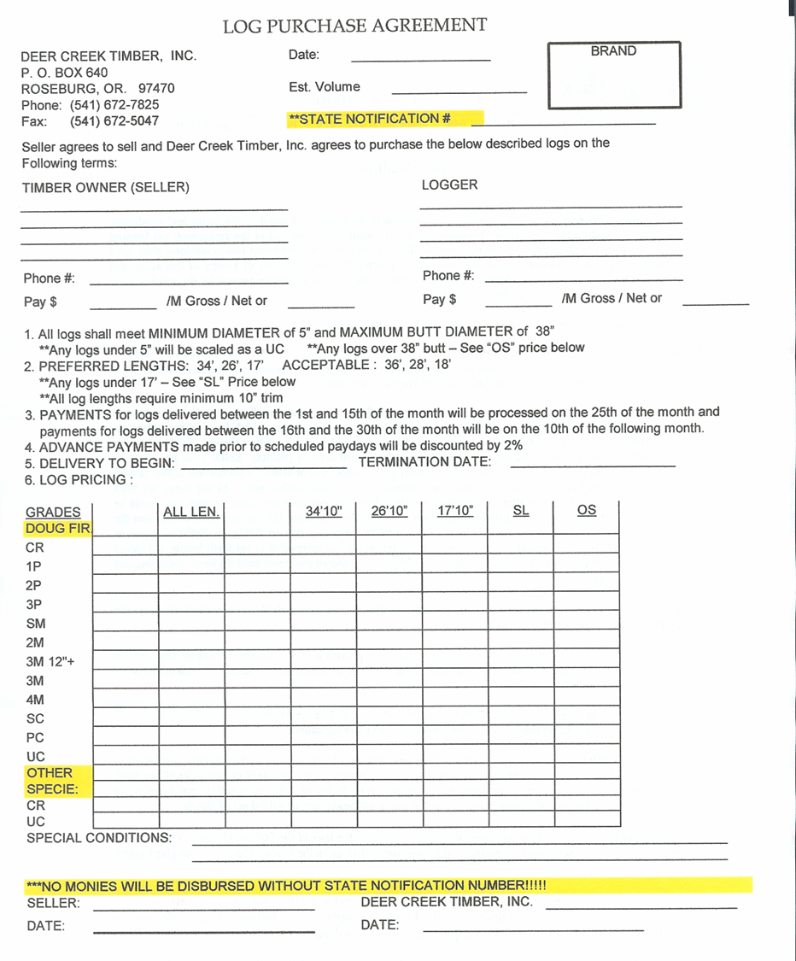
Purchase order
Grade
Diameter or length breaks within log grade
Maximum and minimum length or diameter
Length as a percentage of gross volume — discourages “short logging”
Domestic (grade) vs. export (sort)
Notes:
Explain payment structure on a PO. Depends on length and diameter. Also talk about preferred length and target by volume.

Slide 21
Bucking
DBH
Typical log lengths (W OR) 40’, 36’, 20’
Length (ft)
75 70 60 48 36 24 12 0
Diam. (in)
5 6 9 12 16 17
Option 1
32’
36’
Option 2
20’
20’
20’
Option 3
20’
20’
32’
Notes:
Total height 100, DBH 16, tarif 36. Merch height 75 ft
This is to show the many different ways a tree can be bucked and that the best bucking option will depend on the PO and preferred lengths.

Slide 22
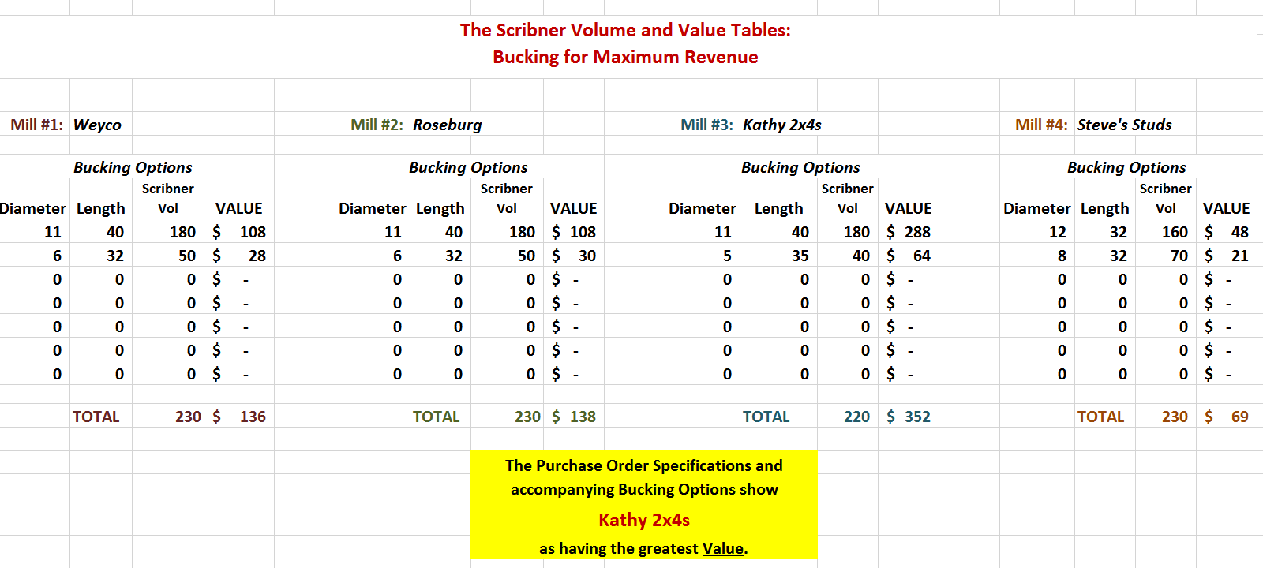
Purchase order
Notes:
Mention the availability of Oregon State University Extension’s “The Scribner Volume and Value Tables: Bucking for Maximum Revenue,” EM 9090, workbook, catalog.extension.oregonstate.edu/em9090, which helps by creating a comparison between different mills and their POs. Remind landowners that this DOES NOT include transportation or logging cost. So a mill might pay better, but that needs to be weighed against transportation cost.

Slide 23
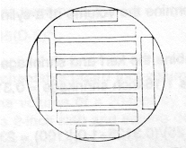
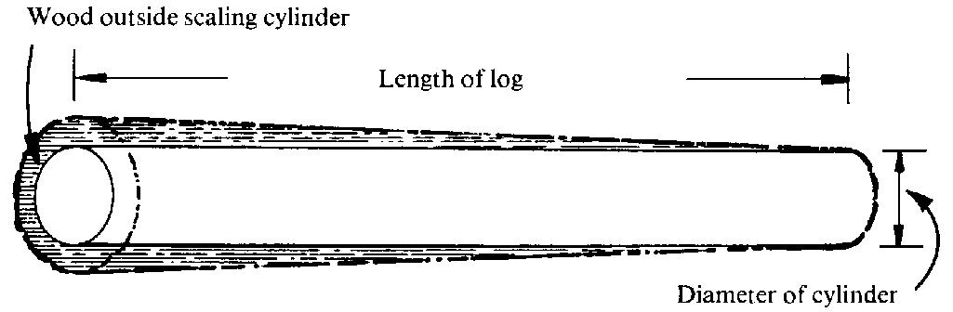
Scribner Log Rule
Created in 1846 by J. M. Scribner
Diagrammed 1-inch boards with ¼” saw kerf that could be cut from cylinders of various sizes
Scribner Volume Table – rounds to the nearest 10 board feet
(current method of payment for log volumes)
Wood outside scaling cylinder is not a factor in volume or value measurements
Length of log
Diameter of cylinder =
small-end diameter
Notes:
Explain basics of Scribner Log Rule. It starts with the small-end diameter, because of the way sawmill works. 1 bf = 1’x1’x1”

Slide 24
Bucking for defect: points to ponder
Stain is not a defect in most sawlog grade logs!
Consider short-logs when there is rot in one end and stain in the other
Payment is on NET scale …
…. payment structure is based on GROSS scale
Knot size (diameters) measured within log’ scaling cylinder
Always limb flush with the bole. …
Remember: if you have a defect in the butt log, consider scaling diameter vs. length deductions!
Notes:
Walk through some defects. Highlight net versus gross scale. This is a good opportunity to talk about log scalers and how defect is taken off the gross volume to final payment.

Slide 25
Find a logger
  Good contractors
  are busy
  Small jobs are not always attractive
  They need lead time of 1-6 months (44%)
Source: Cushing, Belart and Bowers, Small scale forestry, August 2018
Notes:
Talk about logger survey. Good contractors are busy, especially in the summer, and you need to call them well in advance. Discuss typical ways of finding a logger, encourage participants to talk with neighbors who have had logging on their property. If they have had a good experience with a logger, ask them to pass along the contact information. Encourage landowners to create a working relationship with a logger if harvesting in the future.

Slide 26
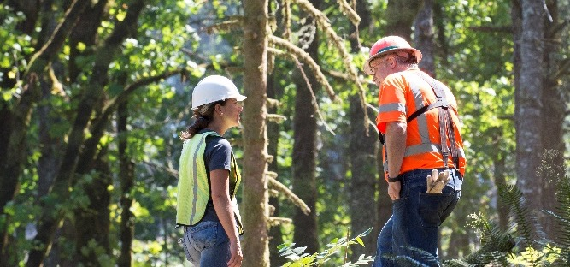
Selecting a logger
  Ask for references
  Previous work
  Proof of insurance
  Get more than one bid!
  Contract?
  Pro-logger certification, if applicable
  Do they specialize in the operation you want to perform (experience?, equipment?)
Photo: Lynn Ketchum, © Oregon State University
Notes:
Make sure insurance is up to date. Find a certified professional logger if possible in your area. Emphasize that landowners should get more than one bid and talk to a logger’s references.

Slide 27
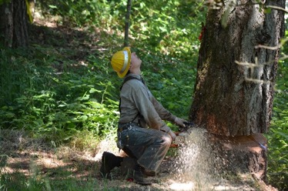
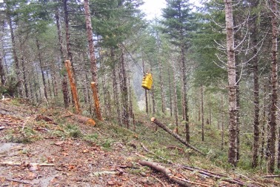
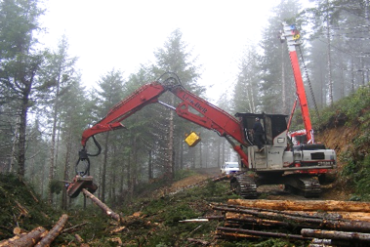
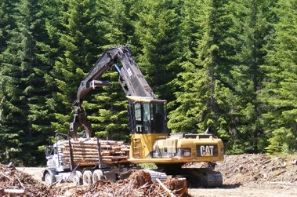
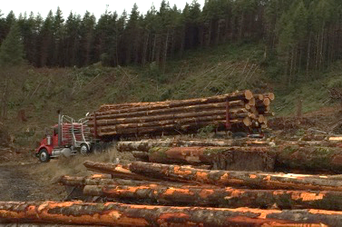
Five steps of timber harvesting
Forest harvesting unit
Landing
Forest road
Felling & bucking
Yarding
Processing Loading
Hauling
Photos: Francisca Belart, © Oregon State University
Notes:
General steps of timber harvesting and where they occur. Briefly explain stages and what happens on each for folks who don’t have any experience with logging.

Slide 28
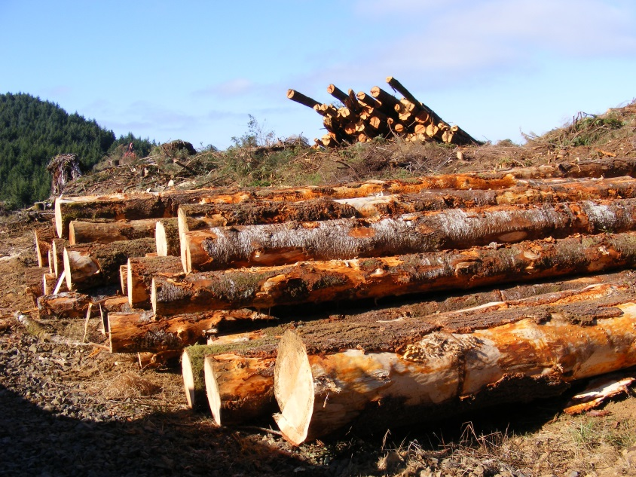
Harvesting costs
Logging cost: fixed + variable
Fixed: mobilization
  Amount of equipment
  A lowboy is about $150-$180/hr
Variable: falling + yarding + processing (logging systems)
  Tree volume
  System productivity
  Topography
Photo: Francisca Belart, © Oregon State University
Notes:
Talk about two main components of harvesting cost. Variable cost depends on stand and site characteristics. Talk about the fixed cost being the same no matter how many trees are harvested. And because of the scale, the more volume harvested, the lower this cost will become. That is the reason why small operations are less cost effective. Add the fact that the logger is not producing during the time the equipment is traveling from one site to another (lost productive time).

Slide 29
Harvesting costs
The more specifications on the treatment,
the more expensive logging will be. (Time = $).
Dealing with nearby buildings takes time and expertise from the timber faller.
Productivity ↓ Liability ↑
Small jobs are labor intensive, labor in logging is becoming increasingly scarce.
The lower the volume removed, the less profitable the operation will be. Depends on your GOALS.
Notes:
Cutting trees and logging around structures and/or power lines is time consuming, involves high risk and will cost more than a regular harvesting operation. You may not get any bids if the loggers are busy. The good loggers are always busy.

Slide 30
Contracts
Photo: Francisca Belart
  Who pays for setup?
  Payment basis?
  Is hauling timber or biomass included?
  Marketing of timber or biomass?
  Who does tree marking if thinning?
  Time of completion
  Is the contractor aware of FPA rules and regulations?
  Replanting?
Notes:
Go through some key elements in the contract, such as making clear who pays for setup costs and whether they are included in the bid. Determine how the contractor will be paid ($/hr, $/mbf, etc.).

Slide 31
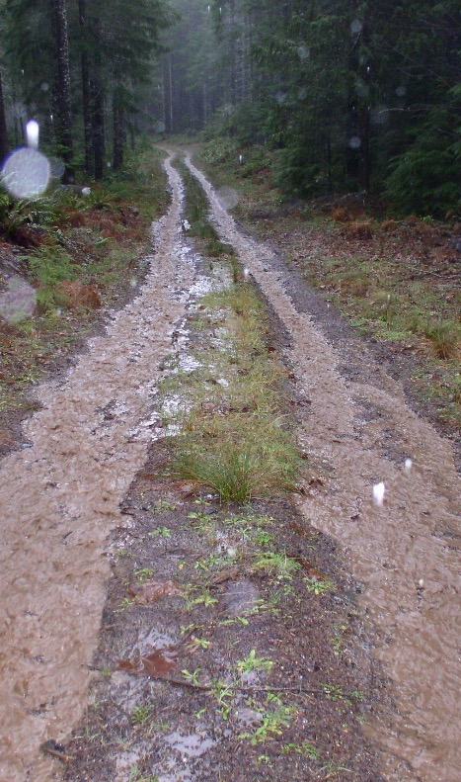
Contracts
  Termination of operations
  Road conditions (pics)
  Post-operation inspection
    - Remedies
  Payment schedule
  Insurance
    Excessive property damage
    General liability
    “Additional named insured”
Photo: Steve Bowers, © Oregon State University
Notes:
Go through some key elements in the contract. For example, under wet weather conditions (rainfall), harvest and hauling will be temporarily suspended.

Slide 32
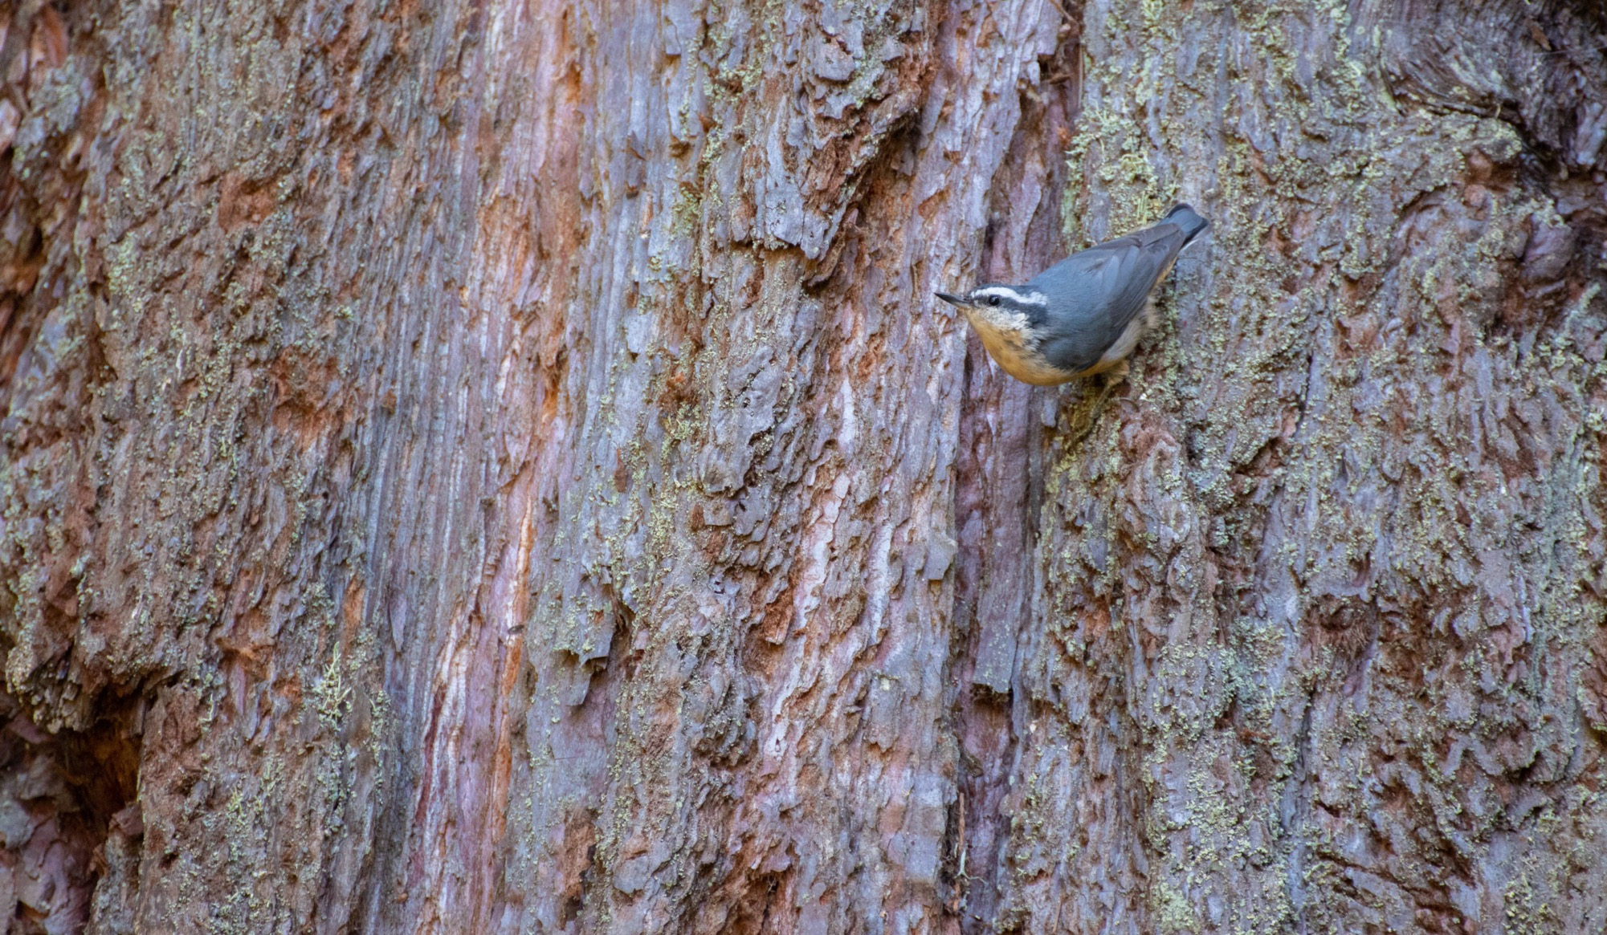
Forest Practices Act
Reforestation
Wildlife habitat
Riparian buffers
Clearcut size
Photo: Francisca Belart, © Oregon State University
Notes:
Classified depending on ground. Remind landowners to order seedlings 1-2 years early. Briefly discuss rules relevant to your area. Save the in-depth discussion for the forest laws presentation.

Slide 33
Monitoring
  It is important to check progress
  Compliance with FPA
  Images are extremely valuable (roads)
  Post-operations
    Roads
    Slash disposal
    Contract agreement (residual damage, remedies)
    (Before they leave!!)
Notes:
Highlight the importance of monitoring the sale and mention that contractors will not bring equipment back to fix something after they have left. It is important to ask for fixes before the contractor leaves. Take before-and-after photos of the site and roads.

Slide 34
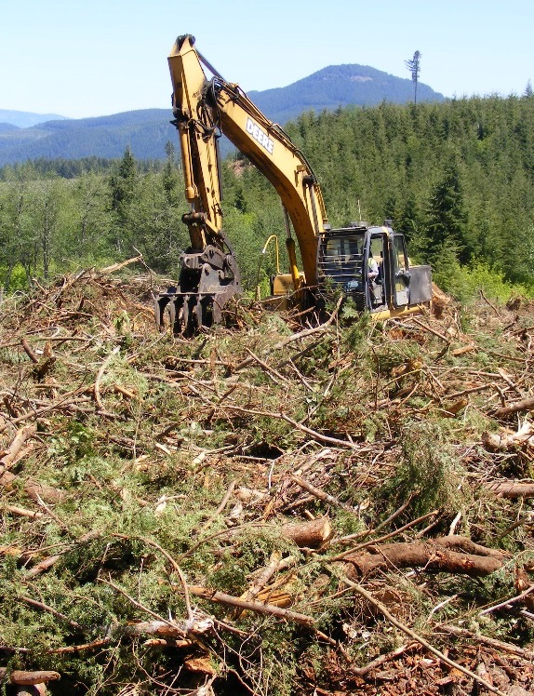
Postharvest considerations
  Slash: Make sure you have a plan for it
  Replant: FPA requirement; order before harvesting!
  Road repair/decommission?
Photo: Francisca Belart, © Oregon State University
Notes:
Remind landowners that they may need to replant, take care of slash and repair roads after the logging operations. They need to plan for that early in the process.

Slide 35
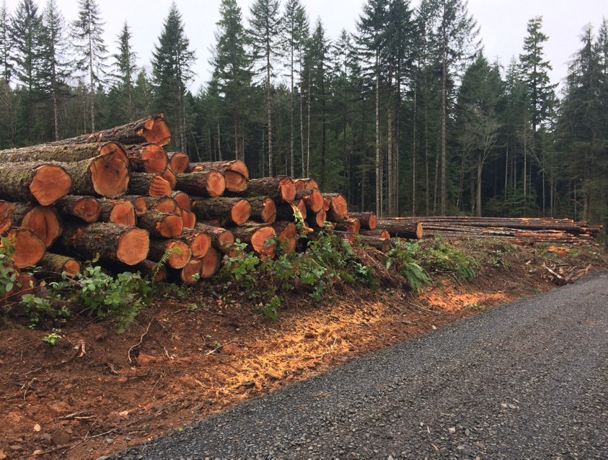
Expectations
$$ $$
Notes:
Talk about having realistic expectations regarding the worth of their trees, harvesting costs and the fact that the forest unit will look very different after the operation.

Slide 36
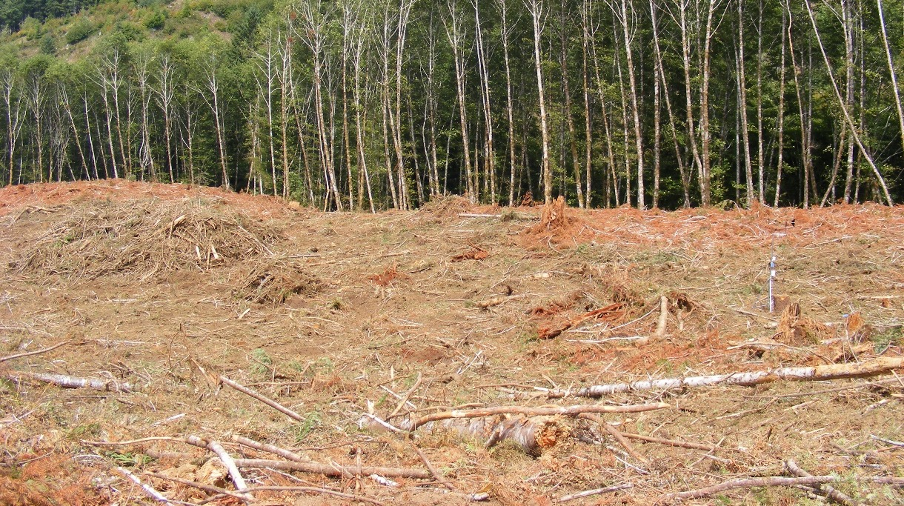
Reality
Photos: Francisca Belart
Notes:
Recommend that landowners harvesting for the first time visit a recently harvested unit so they know what to expect. It can be a shock to landowners who have never done a harvest before.

Slide 37
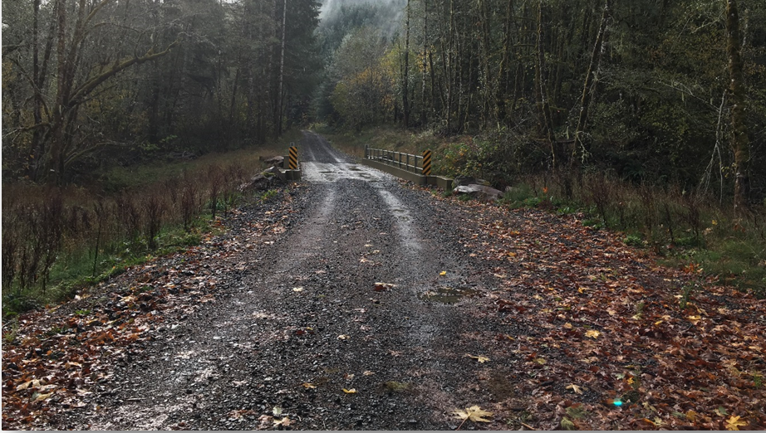
Let’s not forget about ROADS!
“Proper location, design, construction and maintenance of roads can avoid or reduce many undesirable side effects of forest roads”
(Sessions et al., 2007)
Photo: Francisca Belart, © Oregon State University

Slide 38
Why are roads important?
Provide access for
  Forest management
  Development
  Wood extraction
  Protection
  Conservation
Capital investment and land value
Environmental implications
Legal requirements

Slide 39
Road surface: materials
Rock
Dirt
  Needs to be purchased and/or transported
  Higher cost
  Lower maintenance
  All year access
  Better water drainage
  Fewer cross drains needed
  Reduced dust
  Improved traction
Photo: Steve Bowers
Don’t need to buy or haul it
Less expensive
Higher maintenance
Might not be operational all year
Higher potential for sediment
Needs more dips/bars
Decreased stopping distance for same speed
Notes:
Pros and cons of both types of forest roads. Note: Not all rocked roads will hold up in wet weather. Roads must be constructed correctly.

Slide 40
Road surface: width
Road use | Running surface
 | Maximum width | Preferred width | Optional width
Mainline haul road | 30 feet | 24 feet | 16 feet
Permanent spur road | 22 feet | 16 feet | 12 feet
Temporary haul road | 16 feet | 12 feet | 10 feet

Slide 41
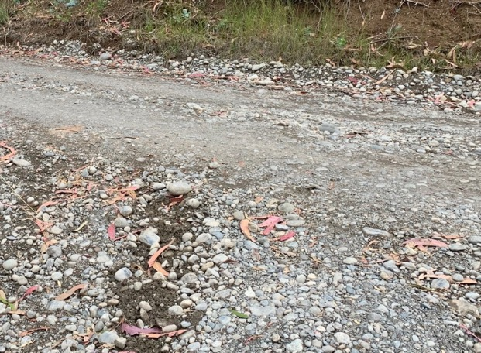
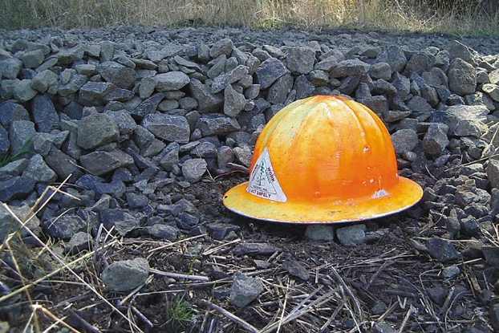
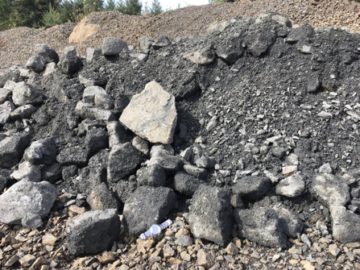
Road surface: aggregate
Pit run: aggregate
from gravel pit or quarry without processing, ↓$$
Sand and gravel: river valley floors extracted from gravel pits then treated
Crushed rock: higher elevations (basalt), drilling and blasting at quarries then treated
Photos: Francisca Belart, Steve Bowers
Notes:
Talk about different types of aggregate and where it comes from. Mention that gravel (round rock) is cheaper but never the best for road surfacing. After crushing, there are always round edges left.

Slide 42
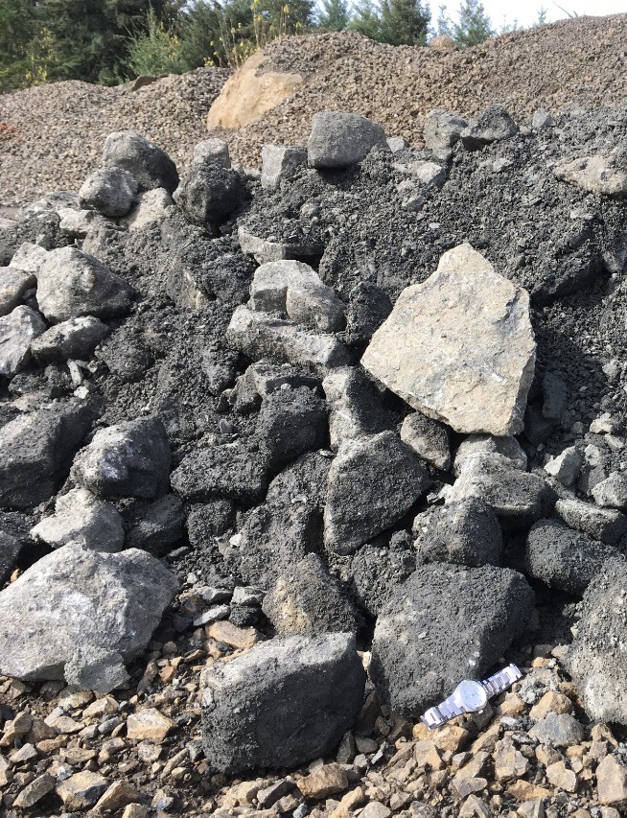
Road surface: crushed rock
Base course: 6-inch minus
Surface course: 3-inch minus, most popular for forest roads.
  1½ in. less used, mostly for steep section, better traction
  1 in. for steep sections, less harsh on tires, compacts really well
Photo: Francisca Belart, © Oregon State University
Notes:
Base course: about 1 ft of 6-inch minus. Fines are a binder; large rock allows good drainage.
Surface course: 6-8 inch lift, best forestry seller.
Pit run: can get any size, not ideal.

Slide 43
Road surface: crushed rock
Single trailer trucks carry 12-13.5 tons
Build in the summer and let settle over the winter
Depends mostly on truck availability
Product |  | Price ($/ton)
1 in. | Minus | $8.75
1½ in. | Minus | $8.50
3 in. | Minus | $8.25
6 in. | Minus Jaw run | $7.25
6-8 in | Pit run | $6.50
P
R
I
C
E
Source: Lonnie Chambers, Wild Rose Quarry, ARI Inc.
Notes:
Talk about different aggregate sizes, prices and level of processing. Price increases as size decreases. Mention how much each truck can carry since transportation is usually the greatest cost.

Slide 44
Road surface: Why fines?
Too little. No contact, no binding, difficult compaction. But is that always a bad thing?
Just right. Good strength, resistant to moisture infiltration
Too many. Aggregate is floating, not strong, generates considerable dust
Barnes and Connor. 2014. Managing dust on unpaved roads and airports. Alaska Department of Transportation. INE/AUTC 14.14
Notes:
Talk about fines: We need them to bind aggregate particles together, but they have to be in the right proportion.

Slide 45
Road surface: cost
Assuming harvesting cost of $350/MBF, 1 mile of rocking @ $70,000
100 MBF is approx. 25 truckloads
Or, 4 acres of site class III fully stocked 60-year-old
Douglas-fir (12 in. + DBH)
Notes:
Talk about the cost of surfacing 1 mile of road and how much harvested volume is needed to pay for that road. Remind people that although that might be a high investment, if the road leads to other timber sales in the future, it might be worth the investment.

Slide 46
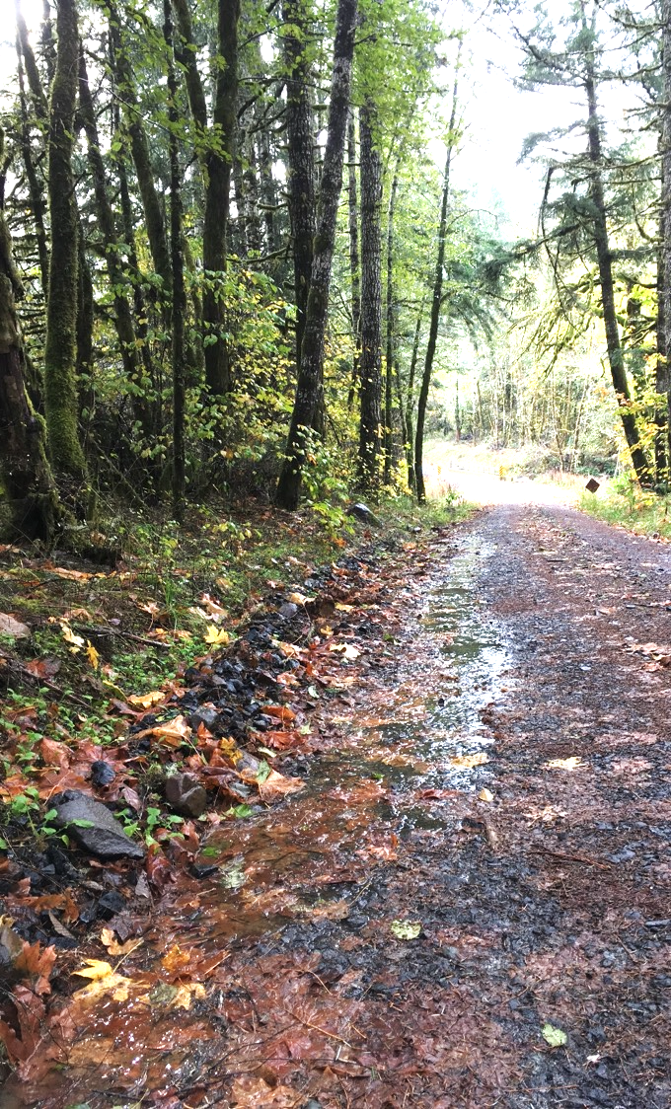
Road drainage
Ditches: collect water falling
on the road
Culverts: carry water under the road to drain side ditch
Broad-based dips or rolling grades
Water bars: usually located
30°–45° to the road
Geosynthetics: drainage and reinforcement
Photo: Francisca Belart, © Oregon State University
Notes:
Describe different road drainage structures and how they work.

Slide 47
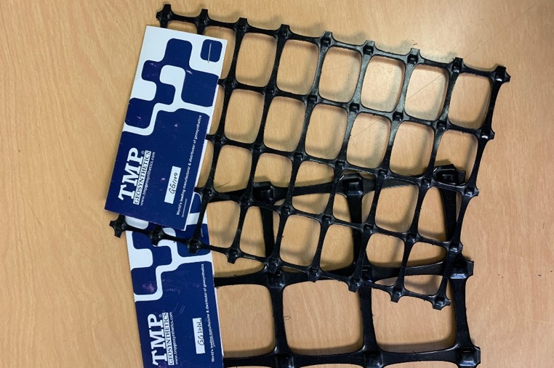
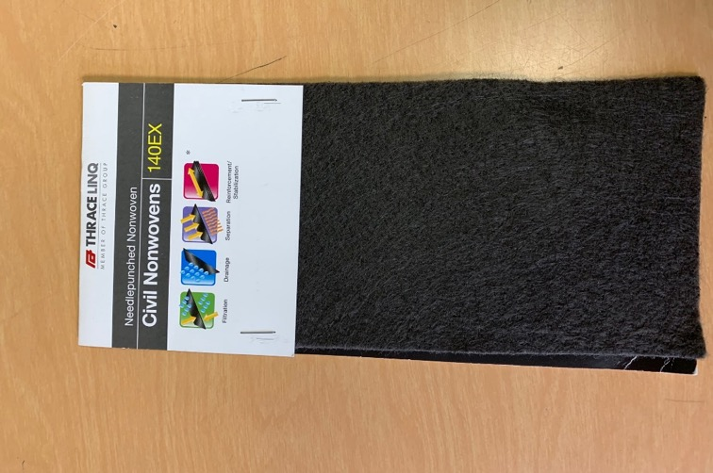
Road drainage: geosynthetics
  Geogrid
  Reinforcement, interlocks rock
  Geotextile
  Separation, strength, drainage
~$10,500 per mile installed
Depending on strength, medium grade: ~$15,000 per mile plus installation
Photos: Francisca Belart, © Oregon State University
Notes:
Discuss geosynthetics and their function. Mention they are generally used in wet spots with weak soils.

Slide 48
Stream crossings
  Culverts: special care with fish streams and sizing
  Low water crossings: access; less maintenance; for shallow/low current
  Bridges: expensive; best option when large volume of water; requires specialized engineering skills
Photo: Steve Bowers, © Oregon State University
Notes:
Discuss different options for stream crossings, special care in fish-bearing streams.

Slide 49
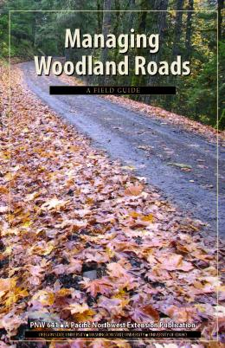
Road maintenance
  Use forms to inspect roads and keep a record
  Prioritize:
    Drainage problems
    Potential for sediment discharge
    Potential fill or cut-slope failure,
    arc-shaped cracks in fill or roadway
    Fish passage/stream crossings
    (culvert outlets, structural deterioration, adequate size?)
Photo: Francisca Belart
Notes:
Keeping a road maintenance inventory is helpful. See Managing Woodland Roads: A Field Guide, PNW 641, catalog.extension.oregonstate.edu/pnw641. The road maintenance form helps landowners keep records. With so many issues on roads, the landowner may have to prioritize. If this is the case, water issues come first, since they carry a liability with water quality.

Slide 50
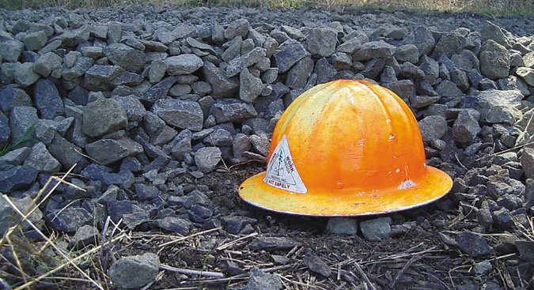

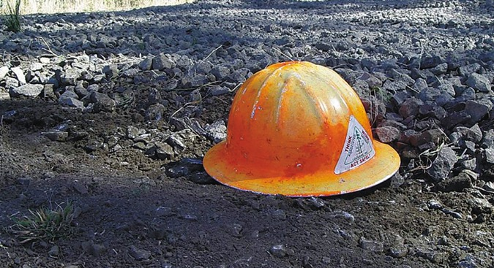

Wet weather operations
  Durable surfacing on road segments connected to streams
  Aggregate placed before wet season
  Clay cohesion in surfacing material vanishes, becomes a lubricant instead of binder
  Discontinue heavy traffic for several days after thaw
Photos: Steve Bowers
Notes:
Reiterate surface drainage (large aggregate) and hydrological connectivity.

Slide 51
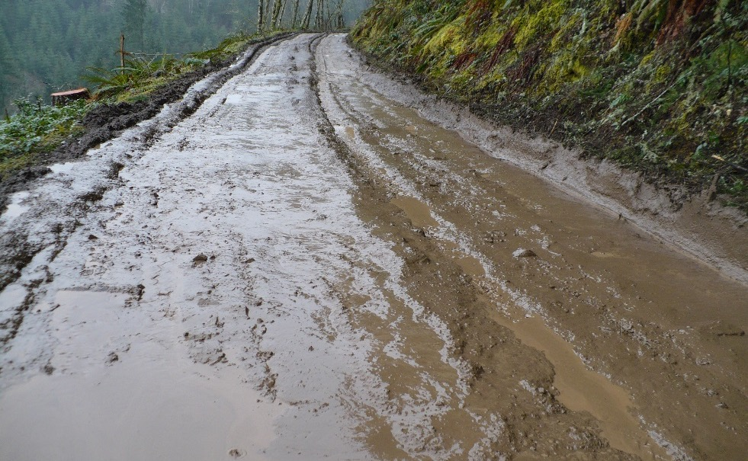
Wet weather operations
Photo: Steve Bowers
Use maximum economically feasible aggregate (3-in+).
Year-round wet spots: max size aggregate or geotextile to provide strength and separation.
Remember: subgrade strength is conditioned by wet weather; road deformation and/or pumping can occur.
Photo: Steve Bowers
Notes:
Establishing stop-hauling criteria is important to prevent sediment production and excessive damage to your road.

Slide 52
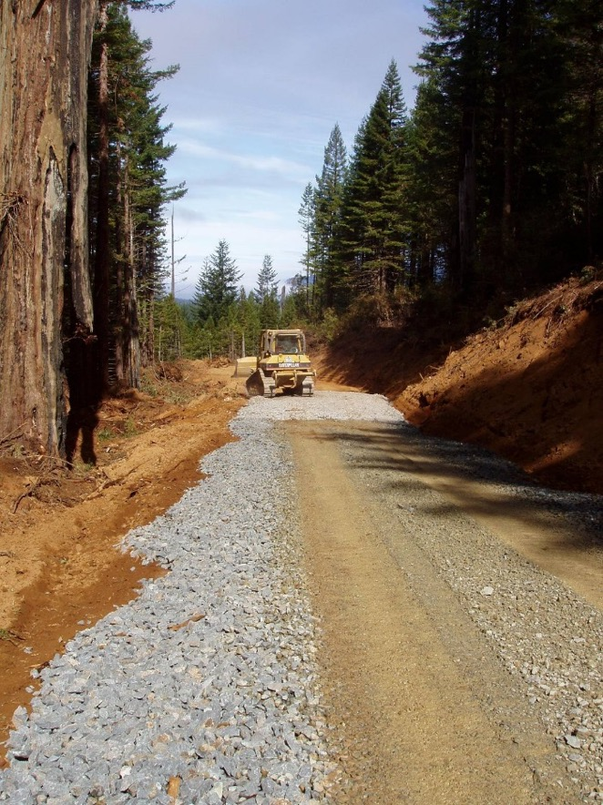
Wet weather operations
Establish criteria for when hauling should stop
Adequate compaction of subgrade and surface
Adequate drainage
Photo: Steve Bowers, © Oregon State University
Notes:
Establish stop-hauling criteria to prevent sediment production and excessive damage to your road.

Slide 53
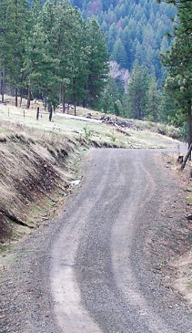
Take-home messages
Roads provide access to manage our forests.
Roads are complex and expensive structures that need constant maintenance.
Roads have environmental implications, especially for water quality and aquatic life.
Roads are regulated to reduce negative impacts on the environment
Photo: Steve Bowers, © Oregon State University
Notes:
Good maintenance and proper construction keep costs low and keep roads free of trouble.

