Slide 1
Working with a log buyer
Presentation prepared by: Lauren Grand, Extension agent, Oregon State University

Slide 2
Log buyers purchase your logs on behalf of a mill or sort yard
Photo: Lynn Ketchum, © Oregon State University
Notes:
Explain here in general terms what log buyers do as they relate to the timber selling process. Describe that they can work for a mill or sort yard, for example. If not too repetitive, comment on how to contact them. Encourage landowners to contact log buyers once they have laid out the harvest boundaries. (In the case of a thinning, contact buyers once they’ve marked the trees for sale.) Invite them to come out to the property and bid on the timber you’ve marked. When you call, be prepared to describe what you have to sell in terms of species, volume, approximate diameters and quality.

Slide 3
Log buyer directory
Company Name • Facility type
Species purchased
Facility Address, log buyer phone • Log buyer name
Westcoast fir • Sort Yard
Douglas-fir, whitewood, cedars
Eugene, 541-444-5555 • Jeanne Anderson
H - O Lumber Co. • Mill
Douglas-fir
Monroe, 541-444-3333 • Nathan Smith
Bros Forest Products • Sort yard
Douglas-fir
Newberg, 503-888-5555 • Doug Jones
Notes:
If possible, provide your participants with a list of log buyers in the area. On the slide, replace our directory with your own and refer your participants to where it is in their participant folder.
Explain that the directory is a compilation of primary log manufacturers (lumber, veneer and fiber operations) and sort yards (export and domestic) in the area. If you have left out any resource such as special wood products (exotic species or portable mills) be sure to let them know. Take a minute to share any other resource for local buyers you may have. For example, Oregon has an online Forest Industries Directory located at www.orforestdirectory.com.
If there is time, explain how the directory is sorted, what information they should expect to find, and how often they should request a revision, since turnover for log buyers can be frequent.

Slide 4
Selecting a log buyer
Contact three — invite each for a visit.
Match your timber to buyer product lines.
Foster a working relationship.
Shop around, but don’t overdo it.
How far is the mill?
Photo: Lauren Grand, © Oregon State University
Notes:
Contact at least three log buyers, if possible, to compare price information. Landowners can find log buyer contact information by searching a local forest industry directory or log buyer list. Landowners will need to provide species and approximate volume (if not at least acreage) information and invite the log buyer to provide an on-site bid. When choosing log buyers, the main goal is to find buyers with product lines that best match the timber on the property, as buyers will pay more for logs that give them the best value for the type of product they manufacture. Keep in mind transportation costs in relation to the price offered for the product. If the landowner plans to conduct timber sales regularly, it is good to build a working relationship with log buyers.
This is also a good time to remind landowners that a particular mill may not want all the logs that they have to sell. In this case the landowner may need to market the logs to more than one mill and will be working with multiple buyers. For example, 5"–11" logs to Mill A, 12"–16" logs to Mill B and 16"+ logs to Mill C.

Slide 5
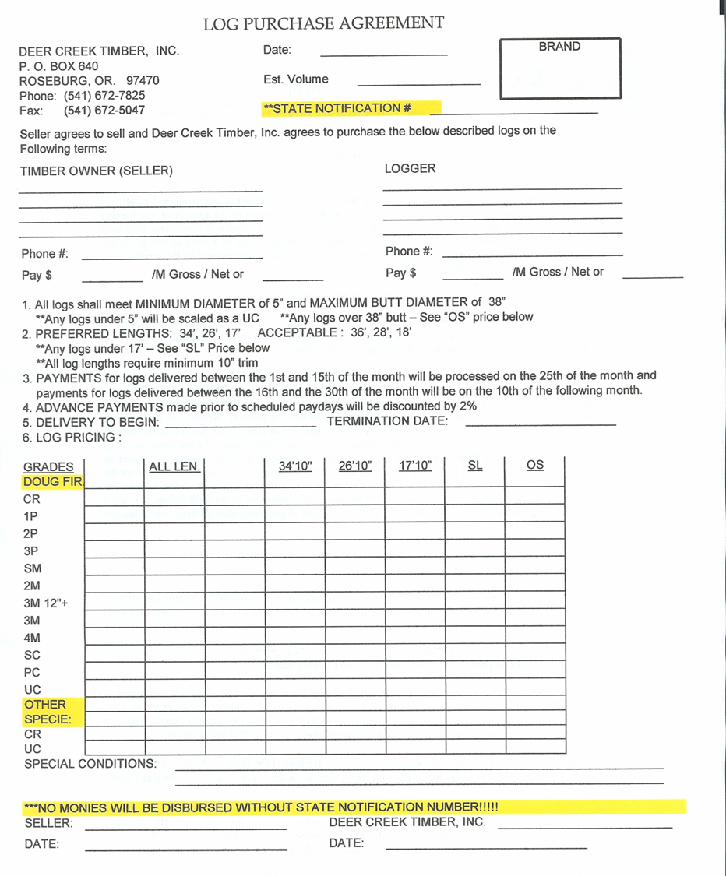
Seal the deal with a purchase order (PO)
Example timber company
Address
Phone
… Before you cut!
Notes:
Once a log buyer is chosen, they will enter into an agreement with the landowner called a purchase order. The landowner must understand the purchase order, which will describe the log specifications and prices paid for delivered logs. The pay structure is listed on a gross scale, but the landowner and logger are paid for the net volume after the deductions for defect are taken at the mill.

Slide 6
Seal the deal with a purchase order
Example timber company
Address
Phone
Buyer/ timber company
Notes:
The remaining slides explain what might be on a purchase order, including information from the log buyer’s employer.

Slide 7
Example timber company
Address
Phone
Seal the deal with a purchase order
Estimated volume purchased
Notes:
The amount doesn’t have to be exact. The mill wants to know roughly how much volume you have for sale in order to keep track of their inventory.

Slide 8
Seal the deal with a purchase order
Example timber company
Address
Phone
Picture of brand to identify log owner
Notes:
A brand is a stamp or imprint of a symbol that associates the logs with the seller. If you do not have your own brand, a consultant or logger working on your project will likely have one.

Slide 9
Example timber company
Address
Phone
Seal the deal with a purchase order
Payment split for you and your logger
Notes:
Most landowners who are selling logs contract out the cutting to a logger. Loggers typically get paid on a percentage or price per unit net scaled. As the seller, you can choose to receive all the payments from the mill and then pay your logger based on the terms of your contract. Or, in this section, you can have the mill split up the payment. The mill will send you your share, and will send a check directly to the logger for their share. This system is usually preferred because there is less money handling and the logger is assured they will get paid on time.

Slide 10
Example timber company
Address
Phone
Seal the deal with a purchase order
Specifications
Notes:
Specifications describe important features of the logs that the landowner must provide in order to avoid price deductions on their logs. This is the main reason that you get your purchase order before you cut and buck up your trees. The specifications in this order ask for preferred lengths of 34, 26 and 17 with acceptable lengths of 36, 28 and 18. If you send them logs that are precut to 38 feet, you’ll not only be losing 2 feet in scale, they may only pay you a fraction of the price of a 36-foot log because they’ll have to manufacture the log differently or send it to another mill.

Slide 11
Example timber company
Address
Phone
Seal the deal with a purchase order
Dates purchase order is valid
Notes:
This is usually a month or two. This can be negotiated for an additional month or two down the road if the harvest is taking a long time. The new price may be higher or lower depending on how the log market has changed over the previous month or two.

Slide 12
Example timber company
Address
Phone
Seal the deal with a purchase order
Grades
Prices
Specifications
Conditions
Notes:
Log grades explain the quality of the logs that the purchaser will accept and they each have associated prices. Better quality logs typically pay more; however, some mills specialize in products made from lower-quality logs. At those mills you may see higher prices for “uglier logs.” Prices are typically reported in per thousand board feet (MBF) or price per ton. Specifications on diameter and length limits may also be listed here, as well as any other features that the mill is looking for. Specifications are very important to follow because they tell the logger how to manufacture the logs into the preferred lengths, which will get you both the highest return.

