Slide 1
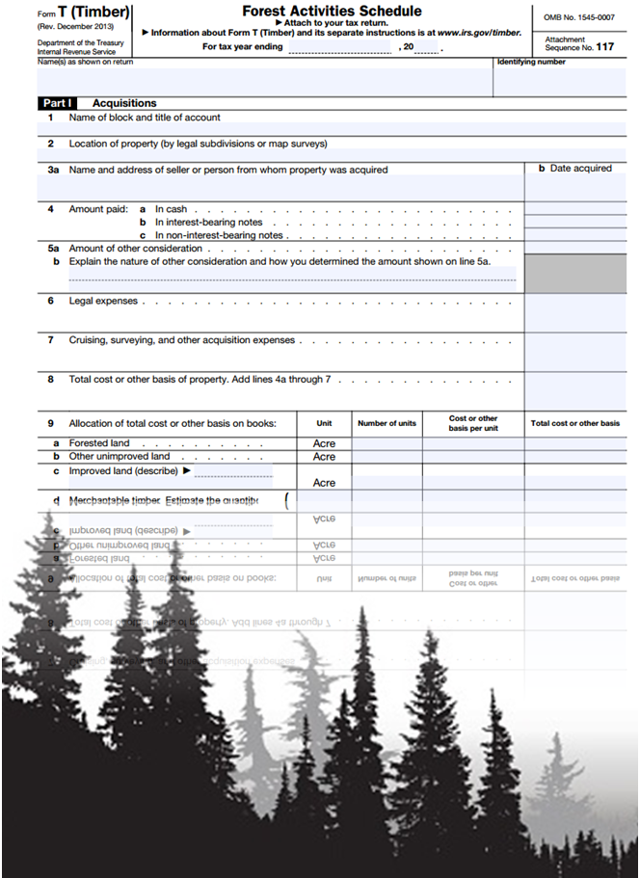
Contracts and Taxes
Presentation developed by Tamara Cushing, OSU Extension specialist,
Forest Economics, Management and Policy

Slide 2
Contracts

Slide 3
Why do we need to talk about this?
Horror stories
Bad actors
Misunderstandings
Protection

Slide 4
A contract is an agreement that:
Describes a promise or set of promises between two parties
Stipulates that performance of these promises is a duty
Provides for a remedy if one or both parties breach (break) these promises

Slide 5
Four basic contract requirements
Agreement — an offer by one party (the offeror) and an acceptance of the offer by the other party (the offeree)
Capacity — the legal competency to be a party to a contract
Consideration — the giving up of a legal right (the exchange of a promise for a promise in a bilateral contract or the exchange of a promise for an act in a unilateral contract)
Legality of purpose — meets local, state and federal laws

Slide 6
Contract development
What do you want the contract to do?
Put yourself in the contractor’s shoes
Sample contracts
Previous contracts
Communication must be clear and direct
Seek help from a contract lawyer

Slide 7
Common items of contention
Start and end dates
Method and timing of payments (really
anything $$)
Property condition following completion of
logging (especially damage and mitigation)

Slide 8
Common items of contention
Payments of Forest Products Harvest Tax,
severance tax
How to resolve disputes
Harvesting schedule
Notes:
This slide includes a reference to the Forest Products Harvest Tax, an Oregon tax. Remove if not applicable or update for state tax.

Slide 9
Taxes

Slide 10
Disclaimers
Tax law is very complex
Often hinges on details
Always changing
NOT tax advice
Notes:
This slide is critical. This is protection against the lack of detail in the presentation and changes that happen after the presentation. The presentation is educational programming only.

Slide 11
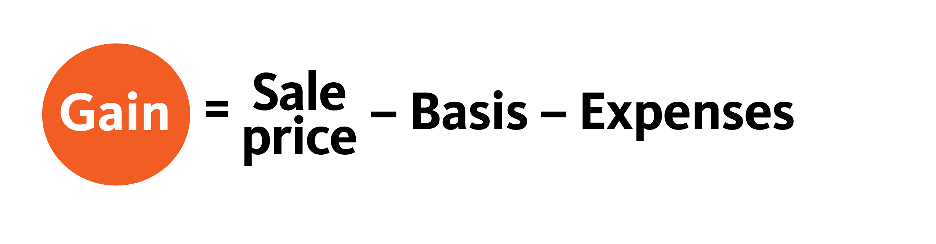
Time of sale
Determination of gain

Slide 12
What is basis?
A measure of an owner’s
investment in a capital asset
Important at the point of sale
  Will reduce your taxable gain!

Slide 13
Determination of basis
Depends on how property is acquired
    Purchase
    Gift
    Inheritance
    Exchange
Reforestation after a harvest

Slide 14
What if a basis was never done?
Retroactive basis determination
Same method as if at time of purchase,
just requires research
Will need to determine timber prices
Volume estimation

Slide 15
Recovering basis
Done through depletion
Adjusted basis ÷ total volume of timber
Calculated for each account
Notes:
Each asset would have its own account. For example, land and timber would each be a separate account. Basis would be in that account to show what was paid for or invested in each of those assets. Can have accounts for merchantable timber, precommercial timber, land, etc. At a minimum, the landowner should have an account for timber and an account for land. If there are buildings, tractors, etc., those would also have an account. This slide talks about using the basis in the account to take depletion, which is a way of recovering the investment prior to calculation of taxes.

Slide 16
Example
Adjusted basis $5,000
Total volume of timber 800 tons
Depletion unit = $6.25/ton sold

Slide 17
Timber sale
Sell 1/3 of timber (267 tons)
Receive $3,204 for timber
Sale expenses of $320
267 tons x $6.25/ton = $1,669
$3,204 – $1,669 – $320 = $1,215 taxable gain

Slide 18
Types of income
Ordinary income
  Example: wages
  Rate: 10%-37% for individuals
Capital gains
  Lower rates
  0 & 15% and 20% bracket
  No self-employment tax (15.3%!)
  Can be offset completely by capital losses

Slide 19
How long timber is held
Must be held for more than 1 year
For gift, donor’s and recipient’s
time is counted
No holding period if inherited

Slide 20
Tax implications
$1,215 taxable gain
Capital gains rate 15%
$1,215 x 0.15 = $182.25 taxes on sale
$3,204 – $320 – $182 = $2,702
after-tax proceeds

Slide 21
Clearcut stumpage sale
$15,000 in basis account
Sale proceeds – expenses – basis = gain
$65,000 – $5,000 – $15,000 = $45,000
$45,000 x (0.15) = $6,750 tax paid

Slide 22
Section 631a election
Breaks sale proceeds into two segments:
Gain from holding standing timber
Value added by conversion into products

Slide 23
631a
Gain from holding standing timber
Deemed sale of standing timber to owner
by himself for FMV before cutting
Capital gain = FMV – adjusted basis
Must elect in writing

Slide 24
631a
New basis is FMV on Jan. 1
Sales new logging
price – basis – & hauling = ordinary gain
expenses

Slide 25
Example 631a
Land purchased in 2016
Landowner cuts 60 MBF in 2018
Logs were sold in 2018 for $9,600
FMV on Jan. 1 was $7,500
Basis = $1,460
Harvest expenses = $1,500
Elect 631a

Slide 26
Example 631a
Gain from sale to self
  FMV on Jan 1 = $7,500
  Basis in timber cut = $1,460
  Gain = $6,040
Capital gain

Slide 27
Example 631a
Gain from sale to self
  FMV on Jan. 1 $7,500
  Basis in timber cut $1,460
  Gain $6,040
Gain on sale
  Sale proceeds $9,600
  Minus basis $7,500
  Sale expenses $1,500
  Ordinary gain $ 600

Slide 28
Side note
Medicare tax — “net investment income”
Effective 2013
3.8%
Capital gains
Passive activities

Slide 29
Reforestation tax incentives
Outright deduction of expenses up to $10K
  Per qualified timber property
Remainder amortized over 7 tax years

Slide 30
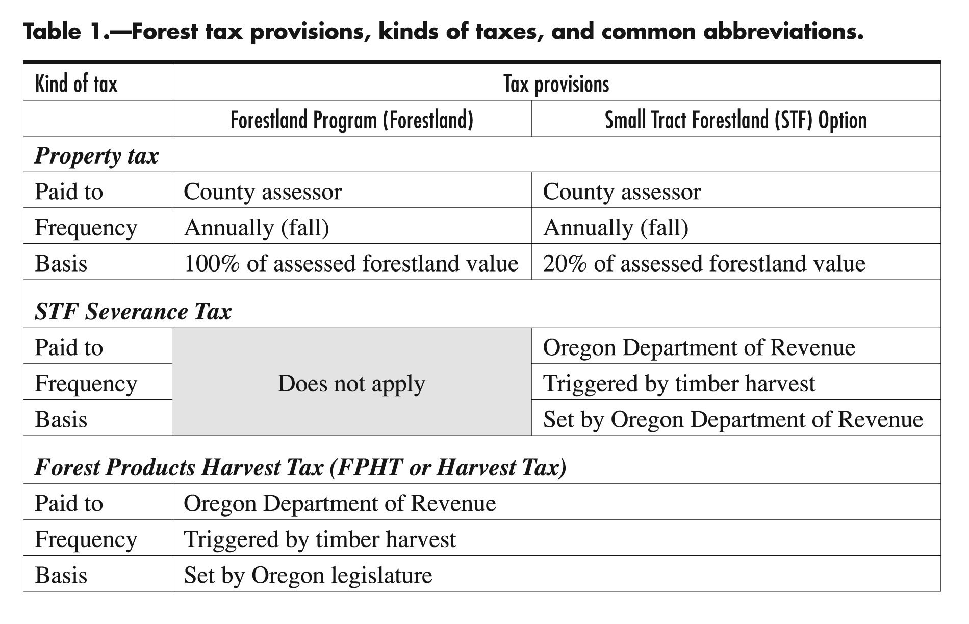
An overview
Notes:
The next eight slides focus on taxes specific to Oregon that are relevant in the year of a harvest. These should be edited for other states as needed, or removed.

Slide 31
Small tract forestland severance tax
Volume-based tax on harvested timber
Property tax paid on 20% of forestland specially assessed value
Severance tax intended to recover remaining 80% when timber is harvested

Slide 32
STF severance tax
What is taxed?
Generally all logs, chips, poles, pilings
from land under STF
Not taxed?
Small (<5" dia, utility grade or lower) logs
Chips from logs utility grade or lower and
where chips become “hog fuel”

Slide 33
2020 STF severance tax
Western Oregon: $6.15 per MBF
Eastern Oregon: $4.78 per MBF
Rates indexed annually
Tied to rate of change for forest land specially assessed values
Notes:
(This slide is OR specific and should be updated each year for the new rates.)

Slide 34
STF severance tax
Max. value increase limited to 3% annually
Due Jan. 31 of year following harvest
Tax supports:
    State School Fund
    County fund
    Community College Support Fund

Slide 35
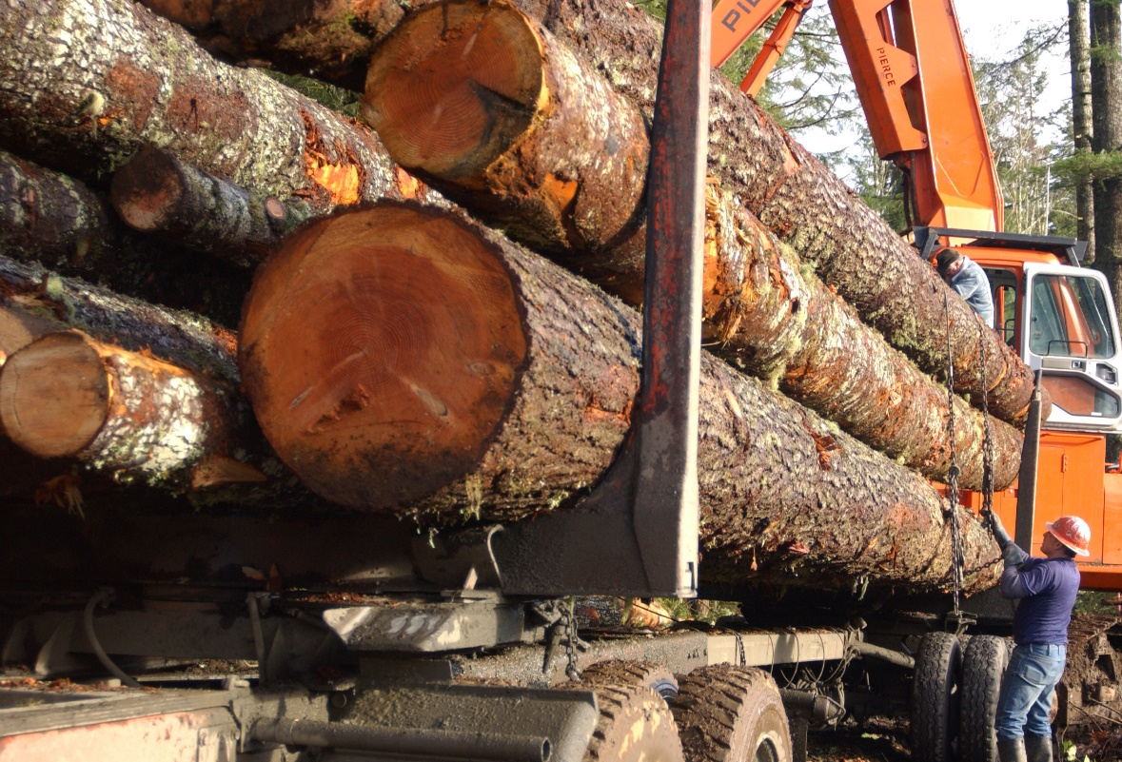
Forest products harvest tax
Volume-based tax on all timber harvested
First 25 MBF exempt
$4.1322/MBF Jan. 1 – Dec. 31, 2020
Funds:
    Oregon Forest Land Protection Fund
    OSU College of Forestry
    OSU Forest Research Lab
    Forest Practices Act administration
    Oregon Forest Resources Institute
Photo: Lynn Ketchum © Oregon State University
Notes:
(This slide is OR specific and should be updated each year to reflect current rates.)

Slide 36
Forest products harvest tax
All timber harvesters must file form even
if no tax is due.
Most people’s tax due Jan. 31 of year
following harvest.
Harvesting large volumes may trigger
quarterly payments.

Slide 37
Forest products harvest tax
What is taxed?
Generally, all harvested logs or chips
All material grade “utility cull and better” and logs sold by ton, including logs chipped in the woods
Not taxed?
Chips from logs that are not utility grade or better
and chips that become hog fuel

Slide 38
Warning!
Change is inevitable.
Provisions are on the block.
Use them or lose them.
Talk to your legislators!

Slide 39
Resources
YouTube videos: thefltc
Forest Landowners’ Guide to the Federal
Income Tax, www.srs.fs.usda.gov/pubs/42921
Oregon property taxes:
www.oregon.gov/DOR/programs/property/
Pages/timber.aspx
Notes:
Update the last reference for taxes specific to your state.

