Slide 1
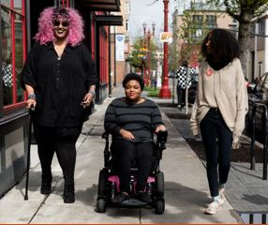
WALK WITH EASE
Oregon State University Extension Service
Join us for weekly virtual support and walk or roll when it is convenient for you.
Class dates:
Start Date – End date
Day & Time
Move more and socially connect this summer!
This program is proven to:
Reduce pain
Build confidence in being physically active
Improve overall health
Participants will receive:
a FREE Walk With Ease guidebook
6 weekly virtual meetings with lessons and encouragement
Learn how to be more physically active
Set and work towards goals
Photo from: https://affecttheverb.com/disabledandhere
To sign up, visit: LINK
Accommodations for disabilities can be made by contacting: PHONE NUMBER or EMAIL
Notes:
Must be in Slide Master mode to swap out photos.

