Slide 1

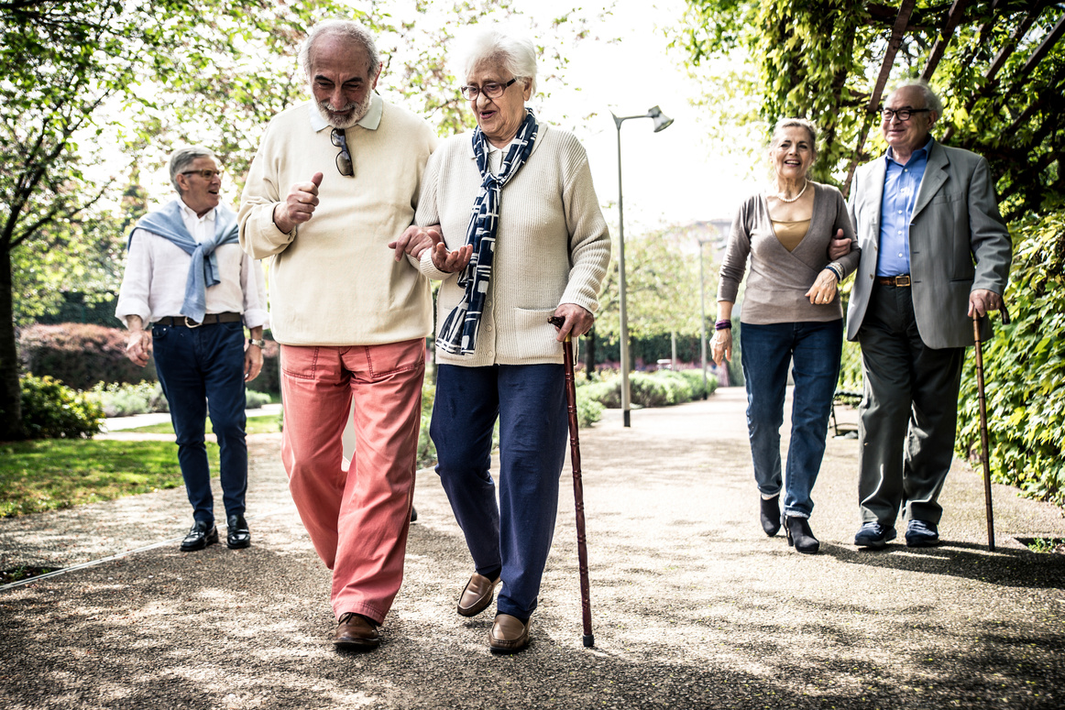


Walk With Ease
a program for better living
The Arthritis Foundation Walk With Ease Program is an exercise program that can reduce the pain and improve overall health. If you can be on your feet for 10 minutes without increased pain, you can have success with Walk With Ease.
walk.oregonstate.edu
“When I started the
program, I was afraid to walk
very far because of my knee pain.
But Walk With Ease helped me start
slow and build up gradually.
Now I am confident in my ability to walk easily without making my arthritis worse.” — Walk With Ease participant
BENEFITS TO YOU
Motivate yourself to get in great shape
Walk safely and comfortably
Improve your flexibility, strength and stamina
Reduce pain and feel great
Arthritis Foundation Certified
Doctor Recommended

